Slide 1
The neverending story
FWCG April 2019 Program
Writing and Drawing with a Bamboo Pen

Slide 2
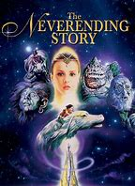
The Movie Theme for April is from "The NeverEnding Story "
a 1979 fantasy adventure book by Michael Ende. The 1984 film received the: German Film Award for Best Production Design in1985. Of interest is the fact that before computerized special effects, this movie presented many mysterious characters in puppetry or large costumes, like the Rock-biter or Luck Dragon.
The Princess needs to save her Fantasia world from the Nothing,
a dark and empty doom, where no imagination exists.
So she commissions the help of a brave young warrior and strangely enough needs the help of the young reader, Bastian. Through many trials and struggles the warrior, Atreyu, can only advance with the assistance of Bastian talking out loud to the book.
His imagination is what the story needs to never end without hope.

Slide 3
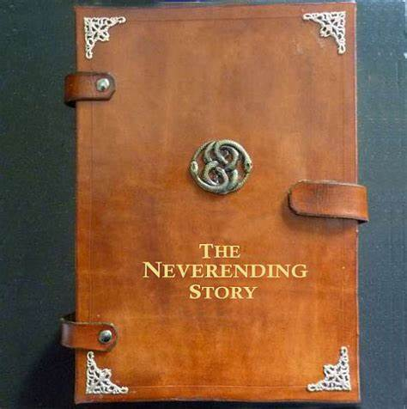
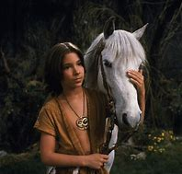
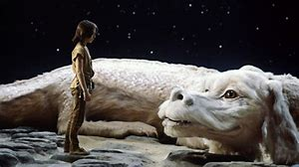
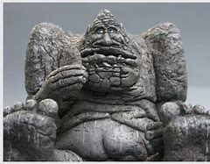
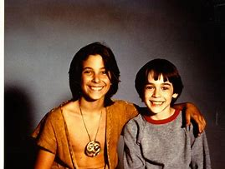
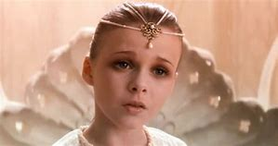

Slide 4
The Movie Theme for April is from "The NeverEnding Story " a 1979 fantasy book by Michael Ende. The 1984 film is about a boy and the adventures that involves himself with the other mysterious characters while he is reading that titled book. Bastian, Atreyu, the Princess & Luck Dragon.
So, we borrow the title for this April Program when looking at historical Never-ending writing and using the earliest of tools known for drawing and writing. As we study the writing tools of the past, we can experience how they were created and appreciate that simple tools can still be utilized today. So let’s continue this never-ending writing that can influence us and others in the present and in the future.

Slide 5
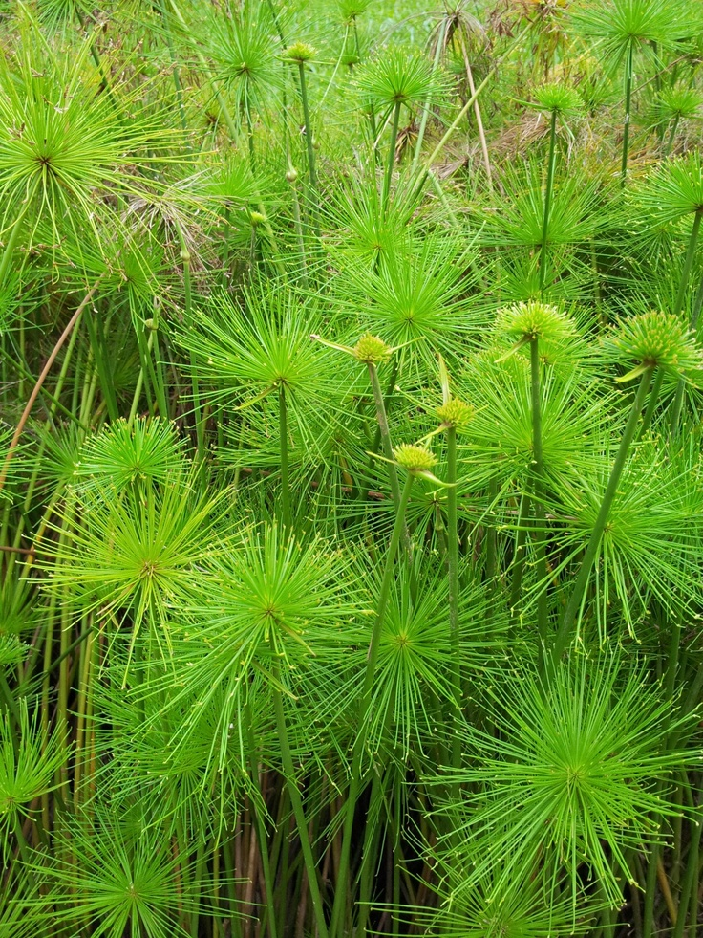
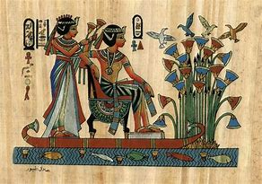
Papyrus Plants

Slide 6
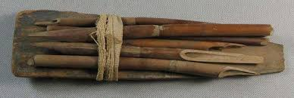
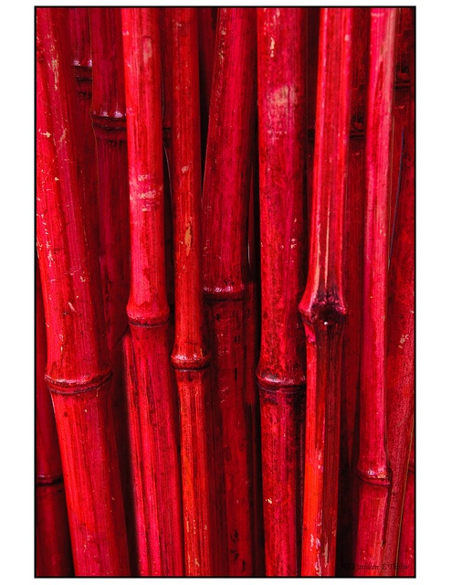
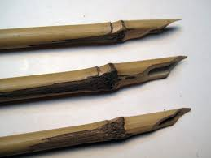

Slide 7
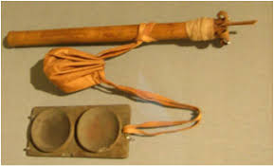
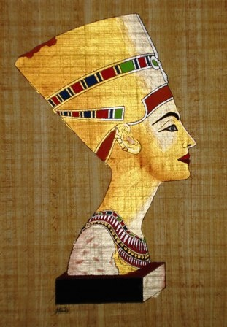
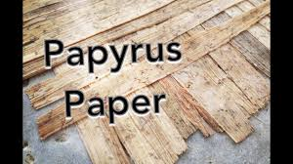

Slide 9
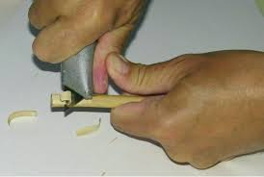
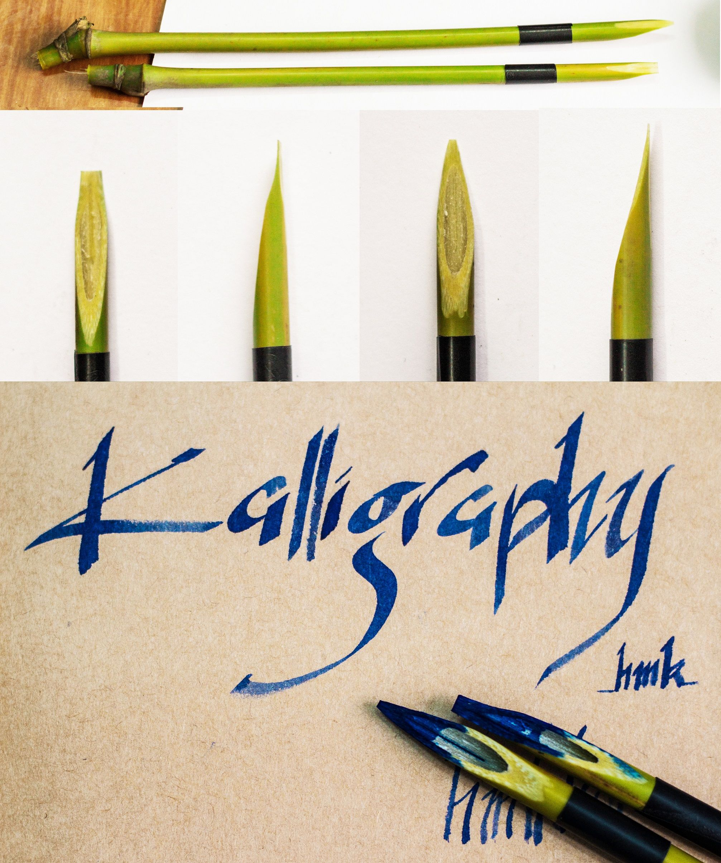
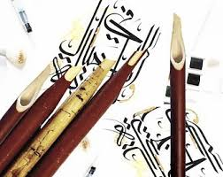

Slide 10
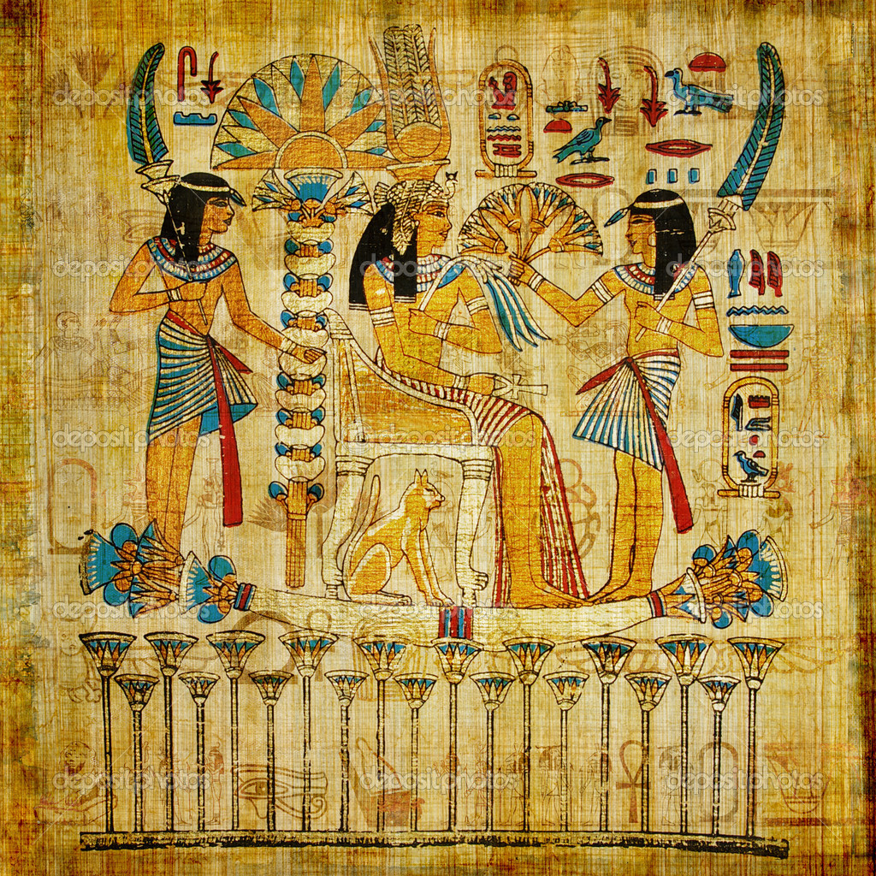
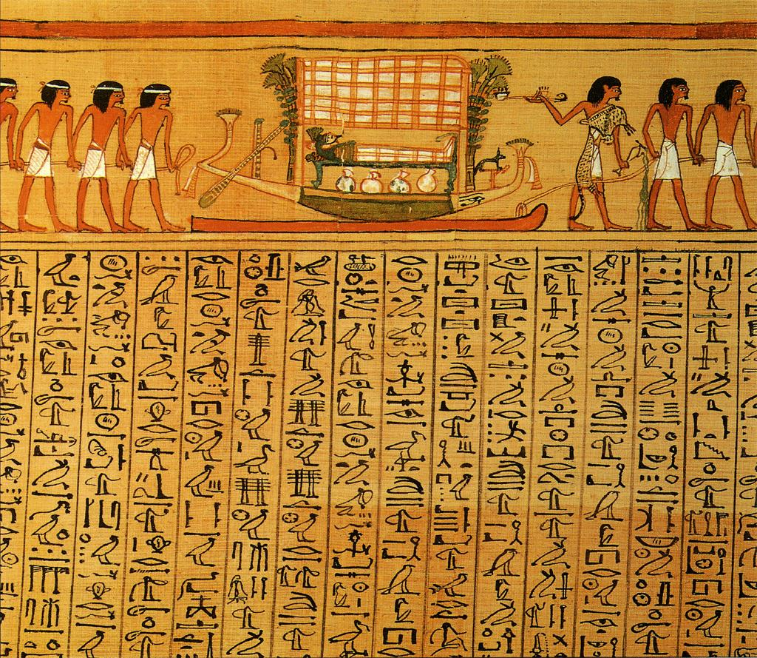

Slide 11
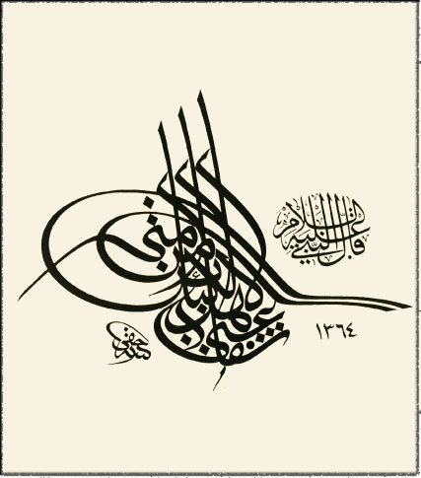
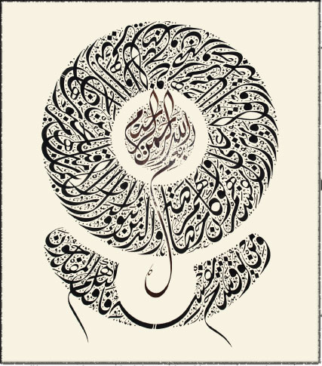
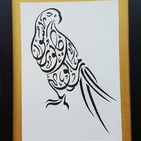
Arabic/ Islamic writing

Slide 12
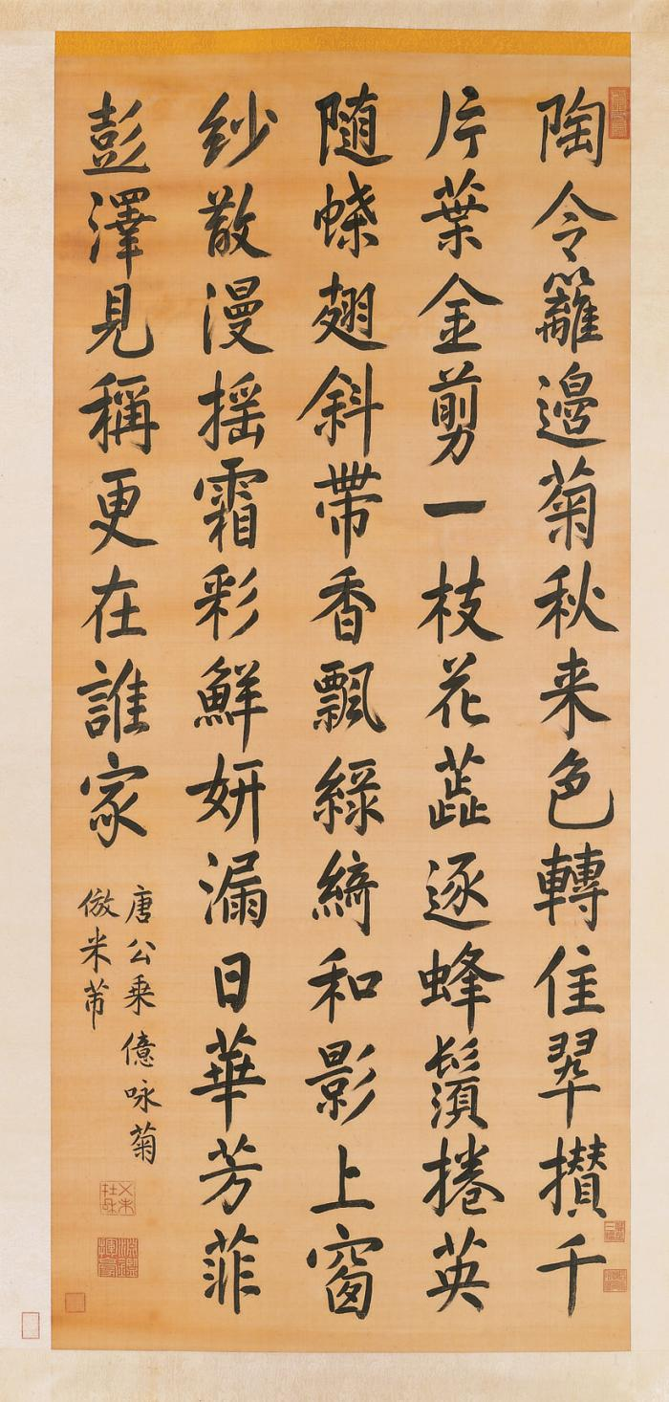
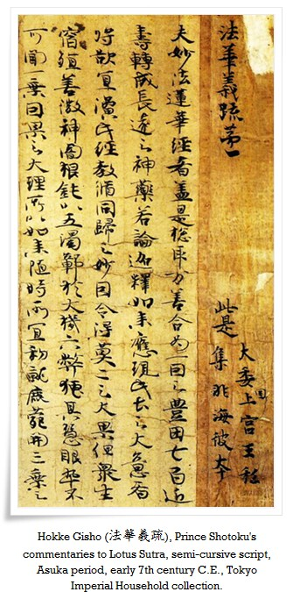
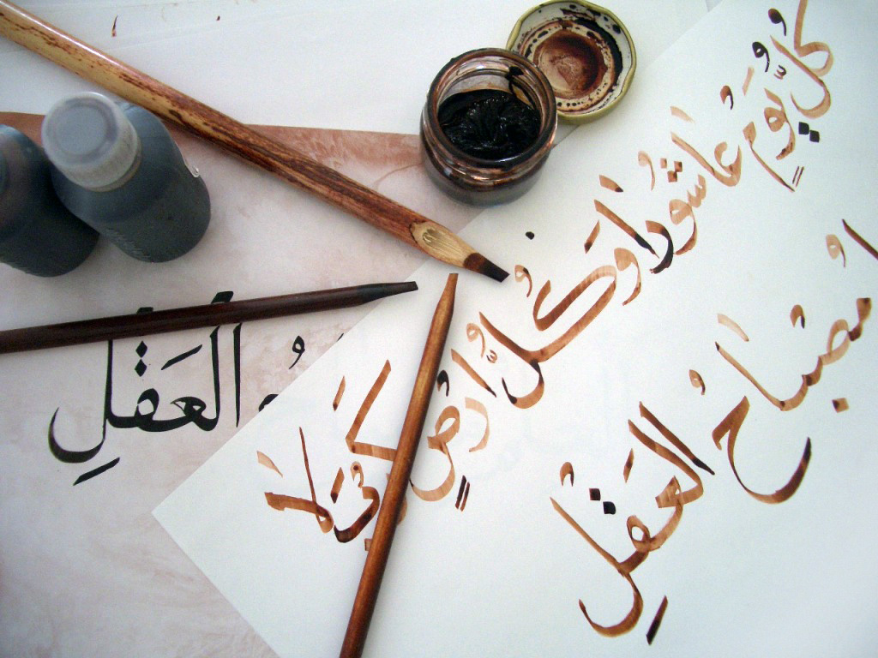
Written styles in
Chinese, left side
Arabic, center
Japanese, right side

Slide 13
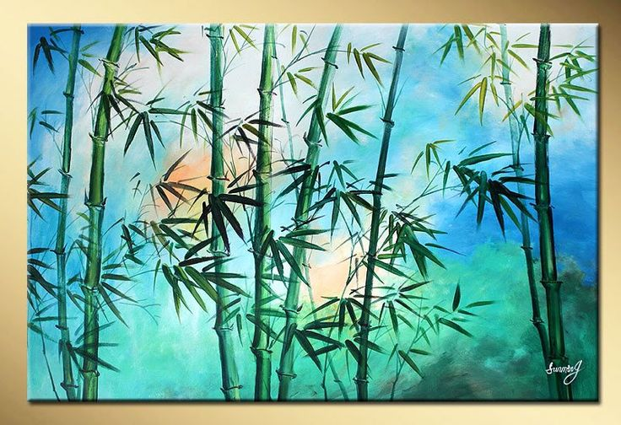
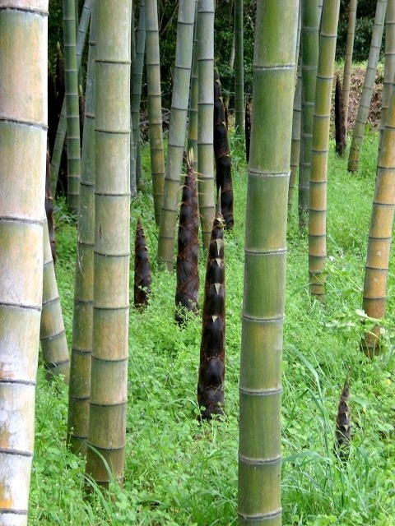

Slide 14
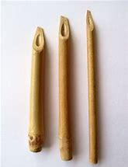
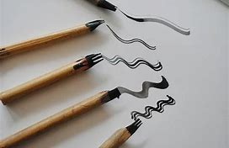

Slide 15
The most suitable paper for calligraphy and sumi-e (墨絵, ink painting) is Xuan paper (宣紙), taking its name from a district of Xuancheng city It already existed during the Tang dynasty period (唐朝, 618 – 907 A.D.), where Xuan paper was originally manufactured.
The main raw materials of Xuan paper are cherry tree bark or sandalwood, bamboo, mulberry, etc.
Xuan paper is sometimes mistakenly called
rice paper

Slide 16
