Slide 1
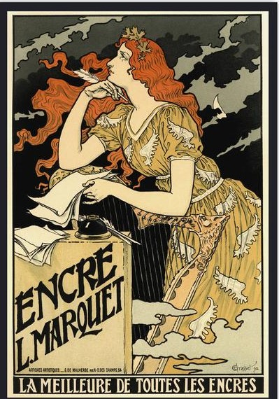
Notes:
PONDERING What 3“ x 3” style? (This old dress?....These are MY COMFY CASUAL CLOTHES. )
Poster by Eugene Grasset. Also see: JULES CHERET posters. HAPPY MOTHER’S DAY!

Slide 2
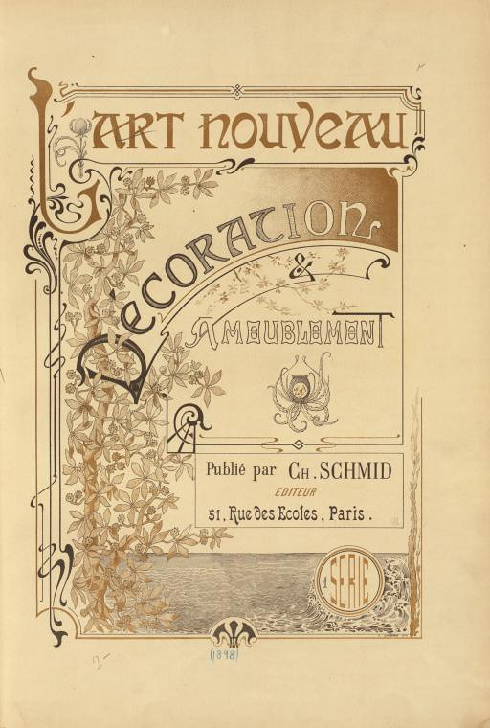
Notes:
Art Nouveau 1890 -1910 Characteristics: Whiplash curves, nature, flowers, free-flowing lettering

Slide 3
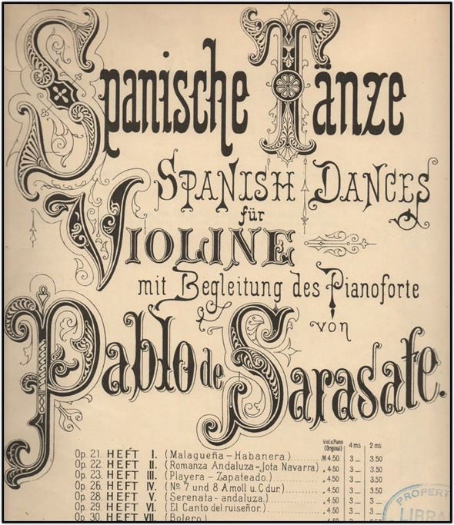
Notes:
“ ARTISTIC PRINTING” of Victorian era – Art Nouveau was rebelling against this style. Multiple letter styles, over ornamentation… although, the Capital Letters are intriguing for “illuminated lettering” and “ornamented lettering”

Slide 4
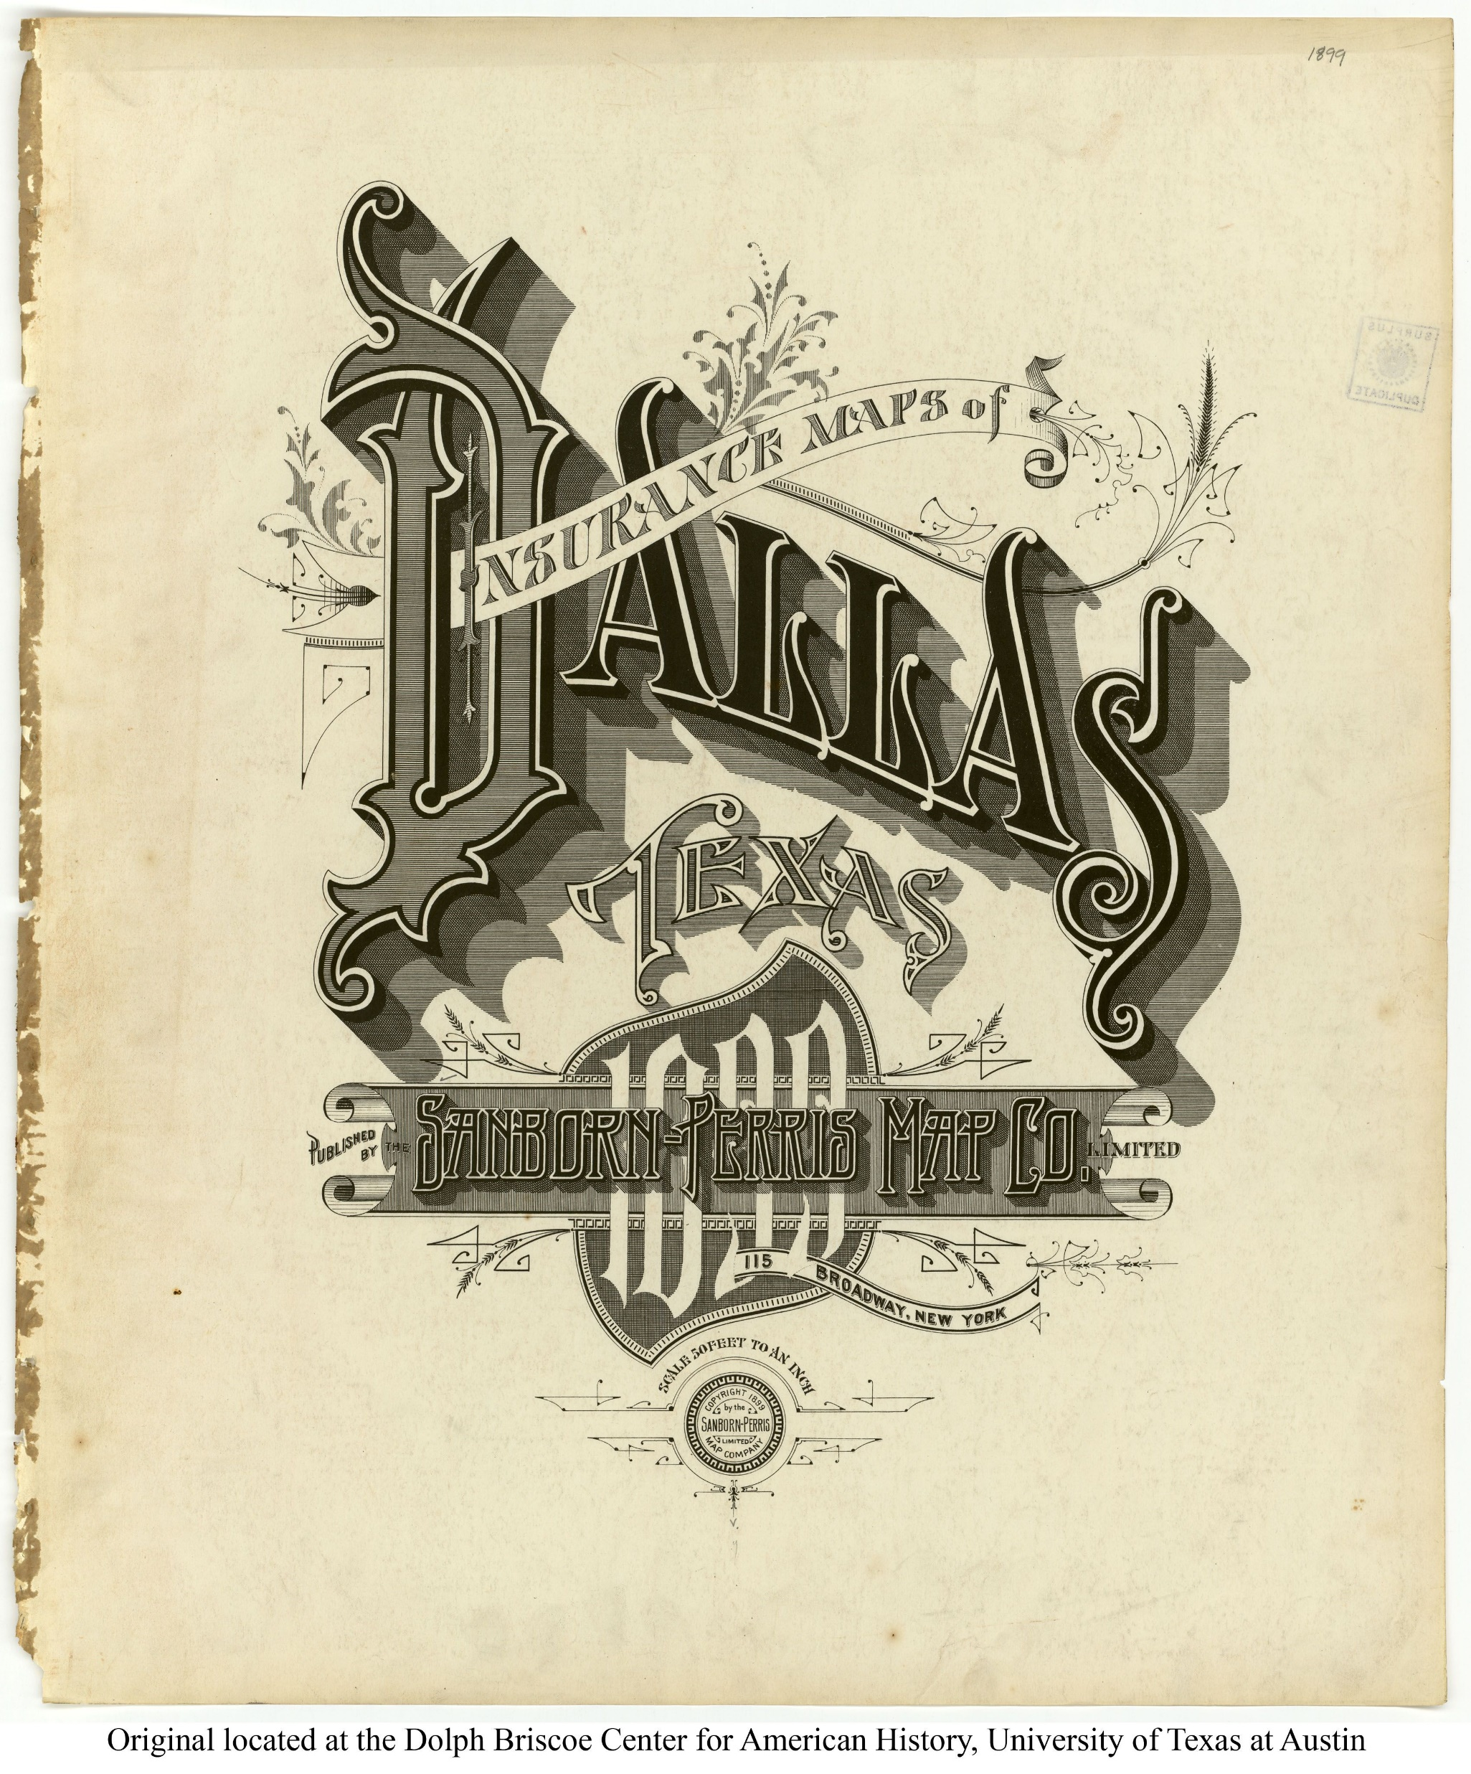
Notes:
I LIKE MAPS --- 1898 Sanborn Fire Insurance Map – Dallas …. A bit gaudy, a bit “Victorian”

Slide 5
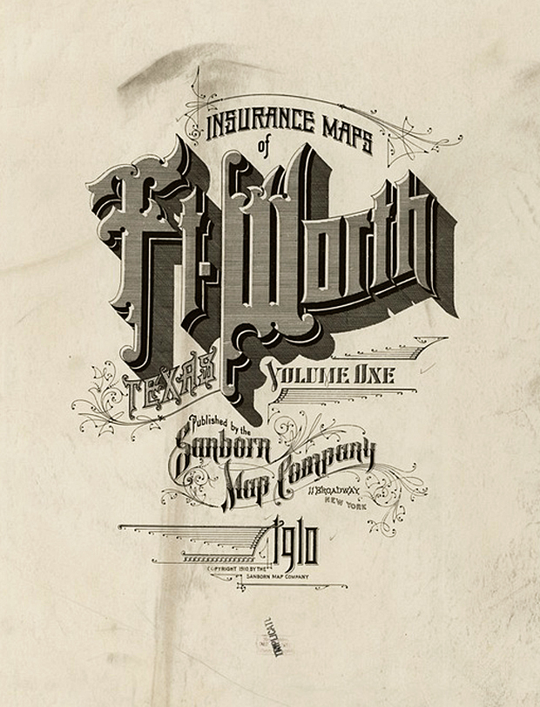
Notes:
Fort Worth Sanborn Map 1910 – F-A-W-N-C-Y! -”ARTISTIC PRINTING” -1910. More floral, less straight-lining… but still there.

Slide 6
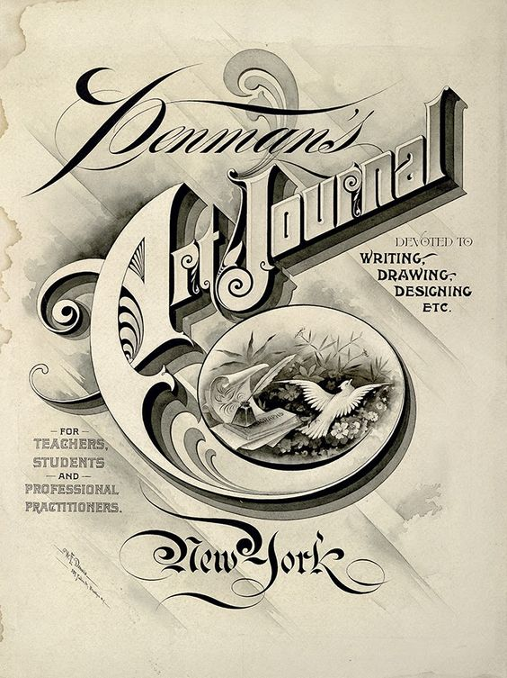
Notes:
IAMPETH mainstay. Early 1900’s, less fanciful than previous editions, but still iffy? I like the letter shading. Great for drawing practice.

Slide 7
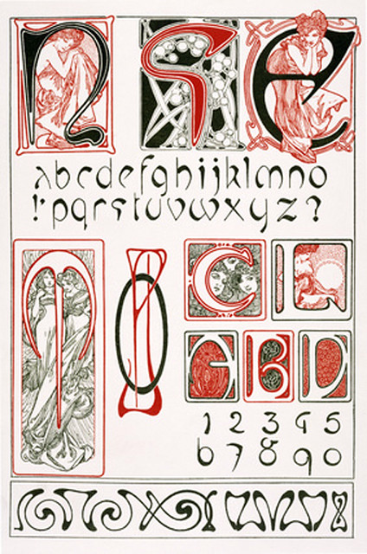
Notes:
Alphonse Mucha lettering –luc.devroye.org --- also see “Georges Auriol” the “father” of art nouveau lettering in PARIS
At luc.devroye.org … see “Victorian Typefaces”, “ Art Nouveau typefaces”, “Art Deco Typefaces”….that is several hundred pages of ideas.

Slide 8
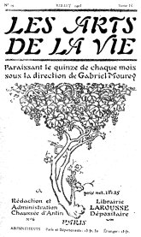
Notes:
George Auriol (1863-1938) French: “Auriol” (1901) became the ultimate Art Nouveau face. Stencil type but may be joined

Slide 9
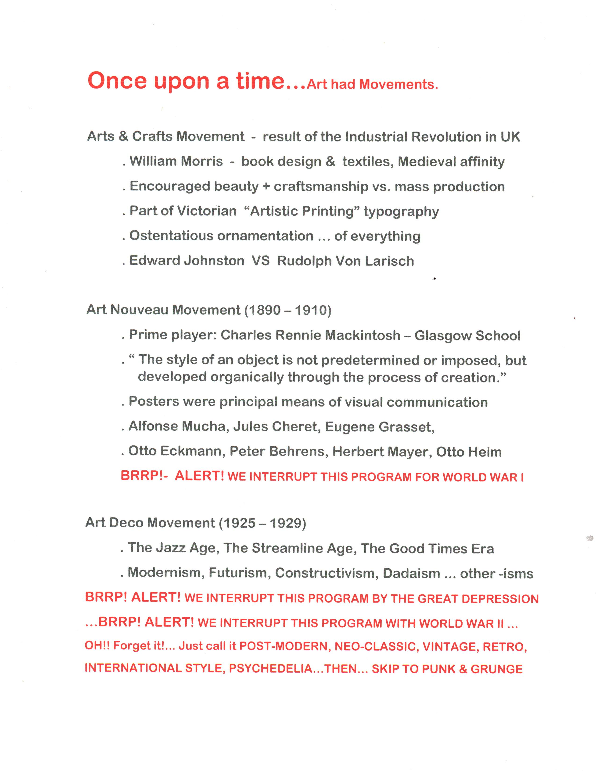

Slide 10
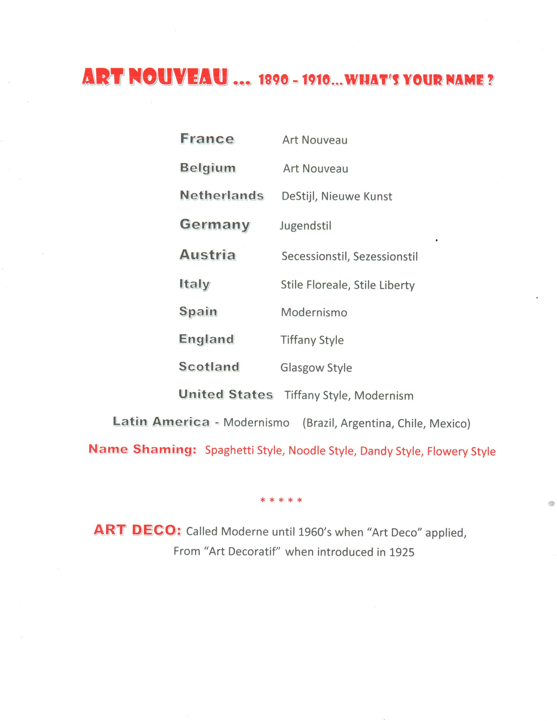
Photo Album
by Cayetano Olivarez
Notes:
SANS SERIF LETTERING AND SIMPLICITY WAS BEING PUSHED OVER ARTISTIC PRINTING

Slide 11
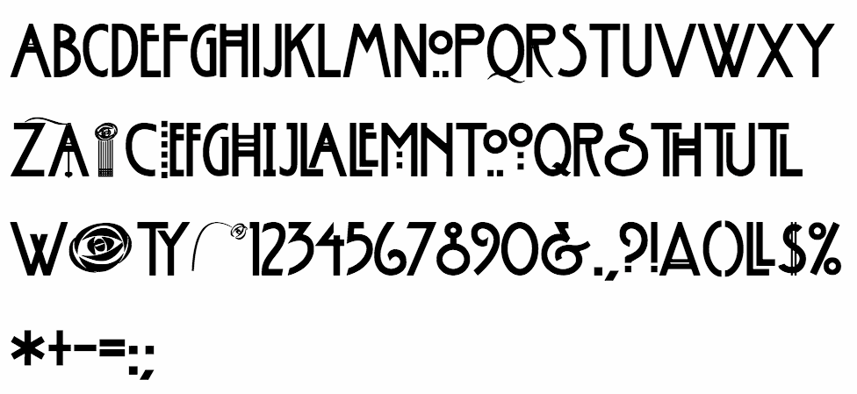
Notes:
Rennie MacIntosh “CLASSIC” typeface. Merged Celtic styles with Japonisme and Arts & Crafts style creating simplistic beauty in form. Tamed the “whiplash curve” that is iconic in Art Nouveau renderings.

Slide 12
Notes:
Charles Rennie Mackintosh – THE MACINTOSH ROSE IS THE PREMIER LOGO FOR ART NOUVEAU

Slide 13
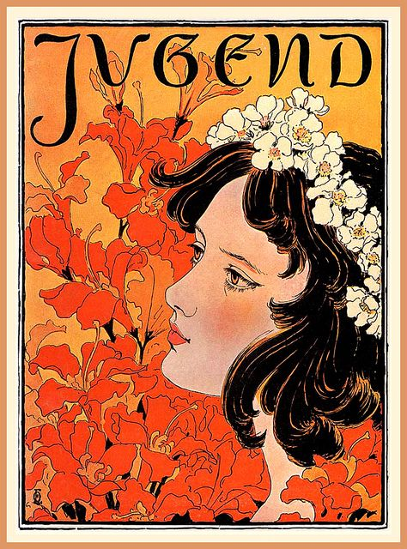
Notes:
JUDENDSTHIL – GERMAN ART NOUVEAU : JUGEND MAGAZINE –1896 OTTO ECKMANN – “Orange Flower” issue

Slide 14
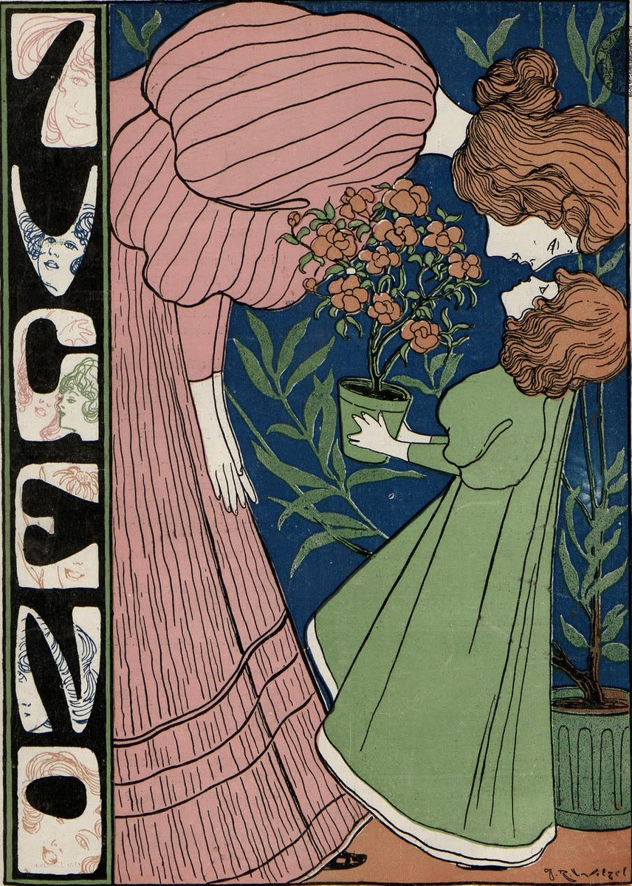
Notes:
JUGEND 1896 - Josef Witzel 7.87”w X 11” H .. Weekly Magazine – every issue new letter masthead. Google: Jugend Magazine covers.

Slide 15
Notes:
BAUHAUS –1919 to 1932 Herbert Bayer’s “Universal alphabet” shown.

Slide 16
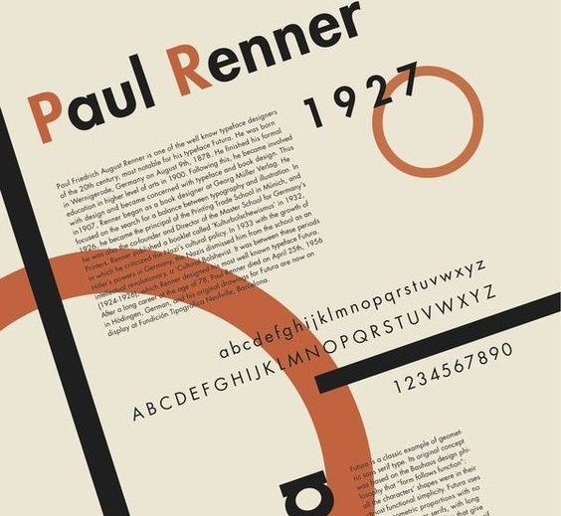
Notes:
FUTURA 1927 – WENT TO THE MOON - STILL USED BY “ABSOLUT” VODKA AND VOLKSWAGEN

Slide 17
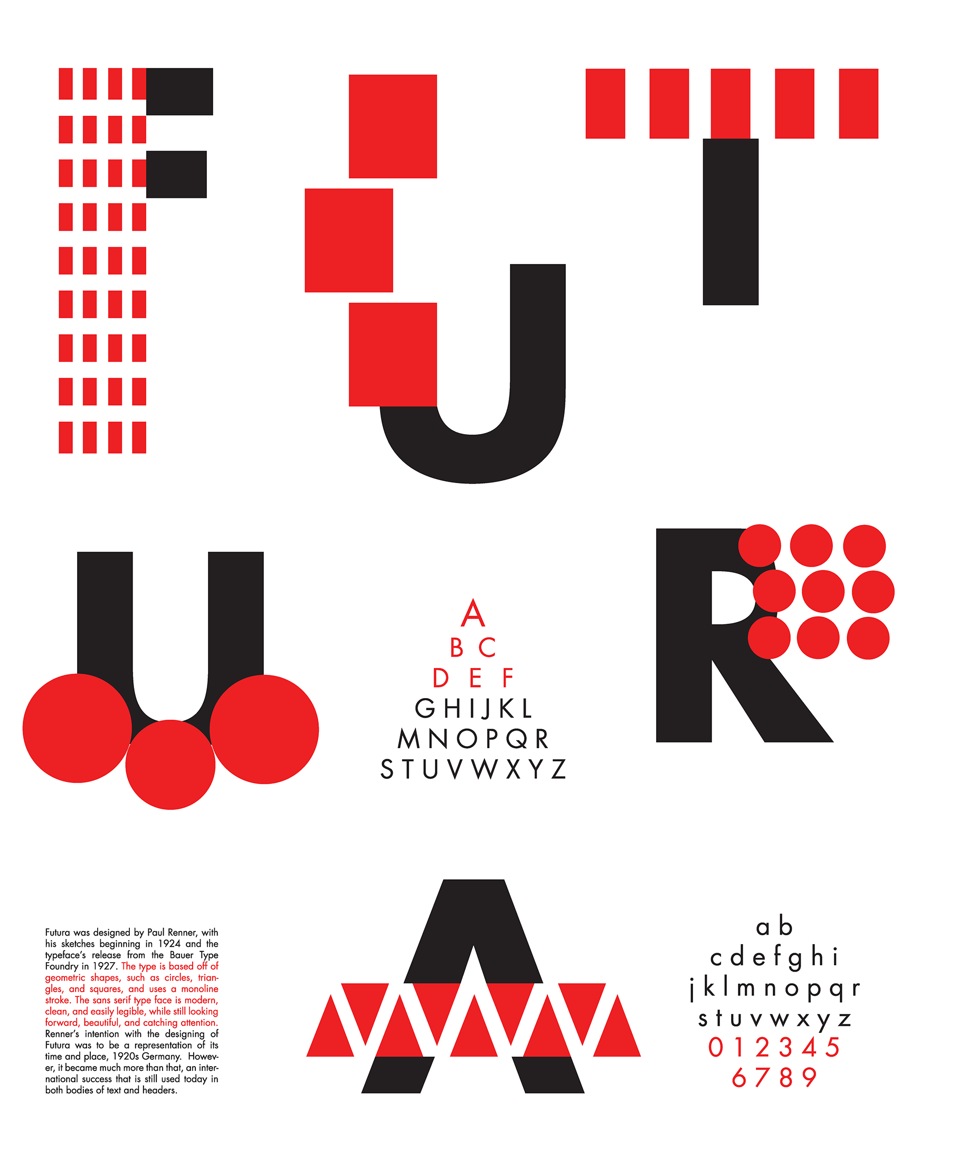
Notes:
1927 Futura – Paul Renner -- 2018 Poster – Stephanie Dickerson

Slide 18
Notes:
A Commercial enterprise – beset by financial problems. Opposed “ the floral style”. Not keen on Edward Johnston style of lettering.

Slide 19
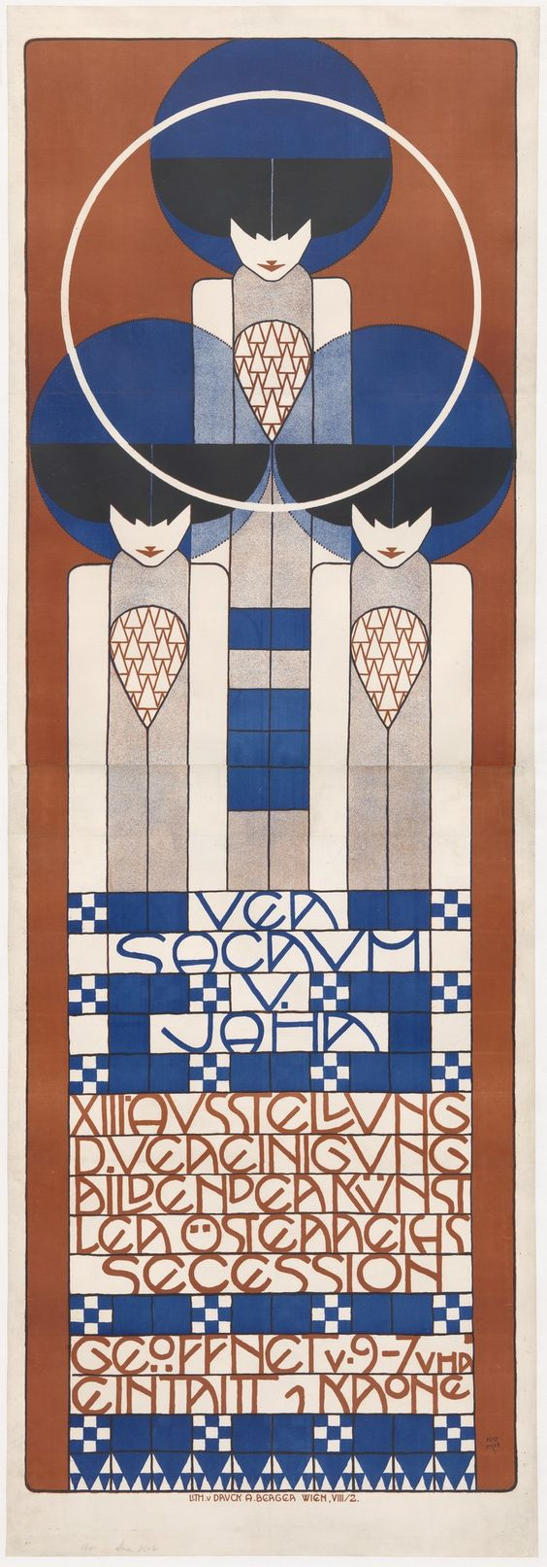
Notes:
VER SACRUM – “SACRED SPRING” - 1902 Poster KOLOMAN MOSER – 13TH VIENNA SECESSION EXHIBITION

Slide 20
Notes:
Alfred Roller Poster(far right) - inspired “Psychedelic” lettering of 1960-70… See Victor Moscoso and Wes Wilson at luc.devroye.org

Slide 21
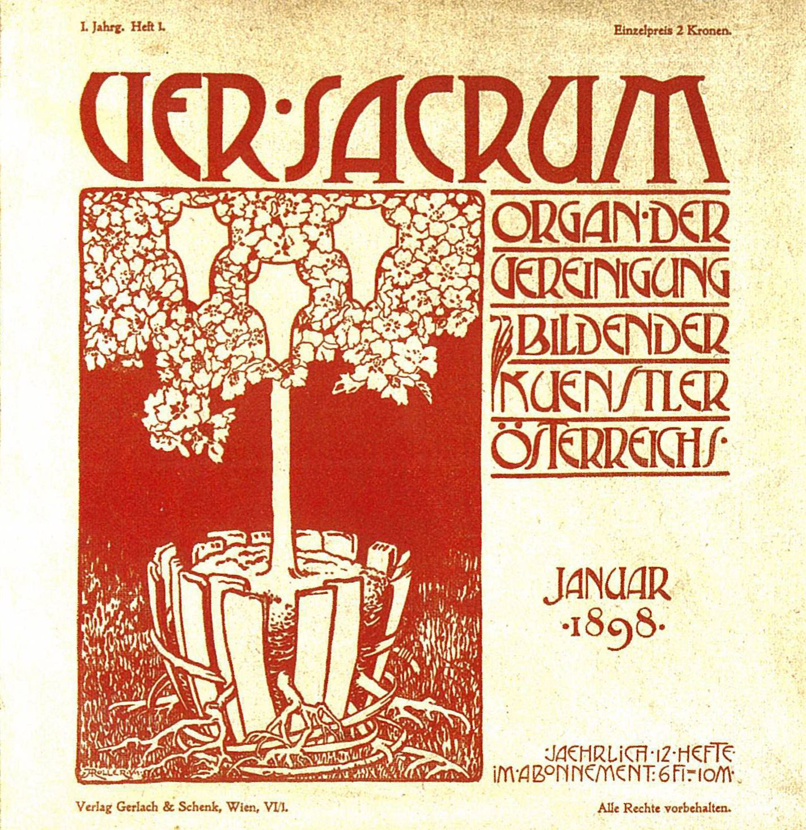
Notes:
VER SACRUM – Vienna Secession Magazine -January 1898 -Initial Issue “ Sacred Spring”

Slide 22
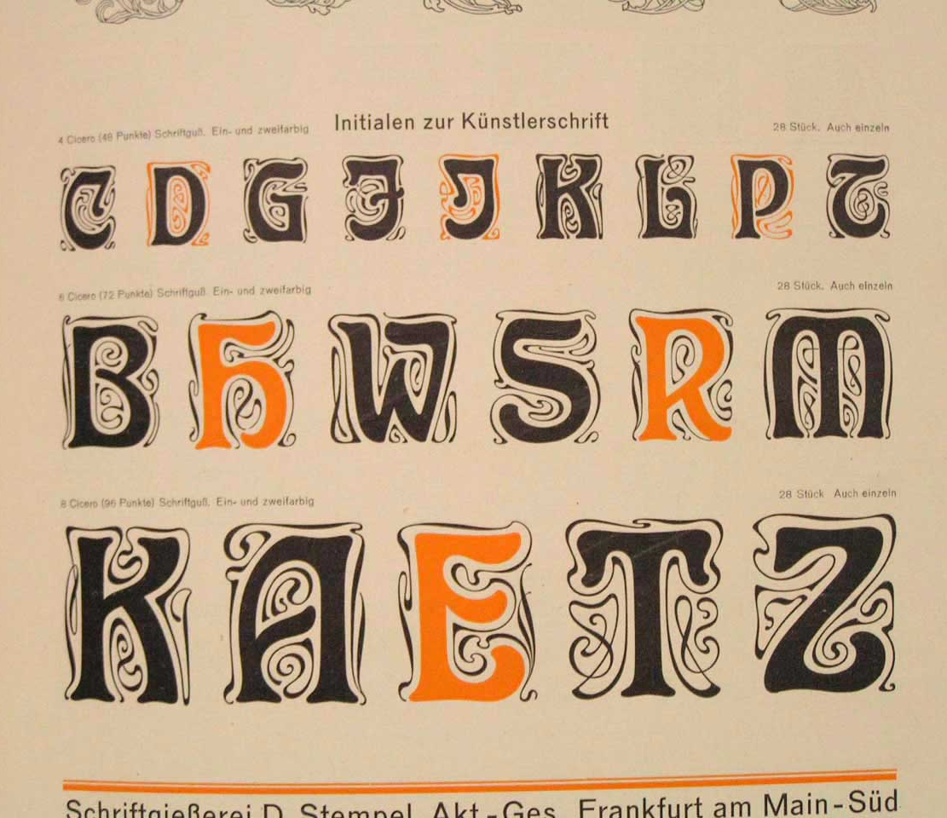
Notes:
Kunstler Initialen – See luc.devroye.org : “ VonLarisch, Rudolph – “ Biespele KunstlerSchriften”

Slide 23
Notes:
Fonderie Deberney et Peignot – major influencer in French Typography. Everything is “Modern” until tomorrow arrives.

Slide 24
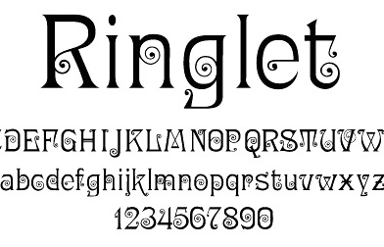
Notes:
By Hermann Ihlenberg 1882 – Revival by Dan X. Solo, 1998 See Hermann Ihlenberg at luc.devroye.org

Slide 25
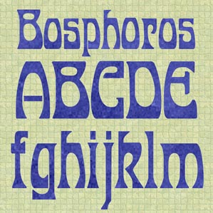
Notes:
Commercial Revival of J.M. Bergling – See “Art Alphabets & Lettering”, 1914 at Archive.org.

Slide 26
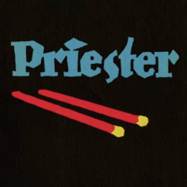
Notes:
Lucian Bernhard – revolutionized advertising – birth of the “logo” style advertisements – simple, effective

Slide 27
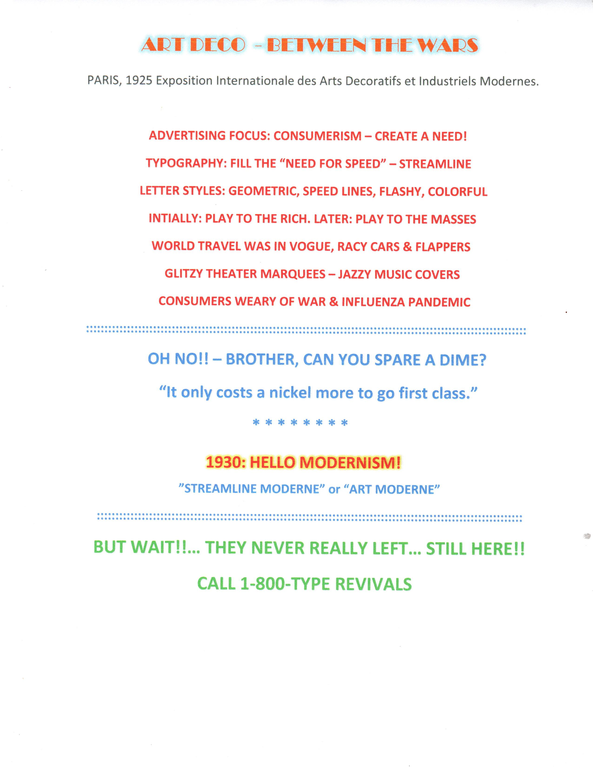
Notes:
Talkie Movies 1927 – Sleek Cars – Flappers – Prohibition - - - and all that Jazz!

