Slide 1
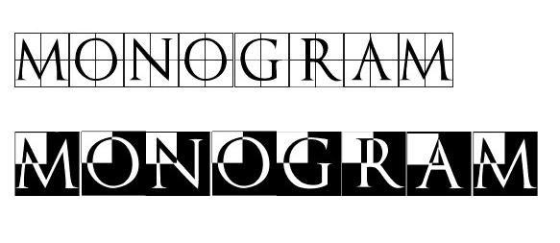
Experimenting with Monograms on Colorful Backgrounds
Learn the Basics of adding your calligraphic monograms on different backgrounds

Slide 2
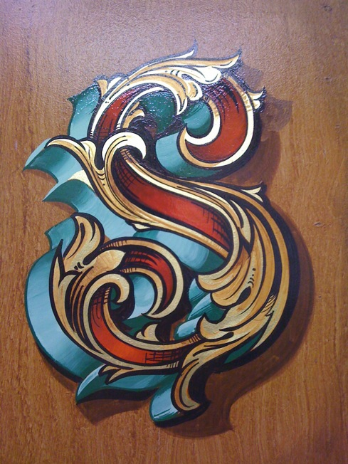
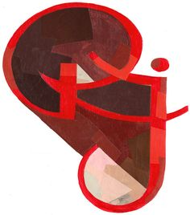

Fancy Initials with shadows or 3-D effects

Slide 3
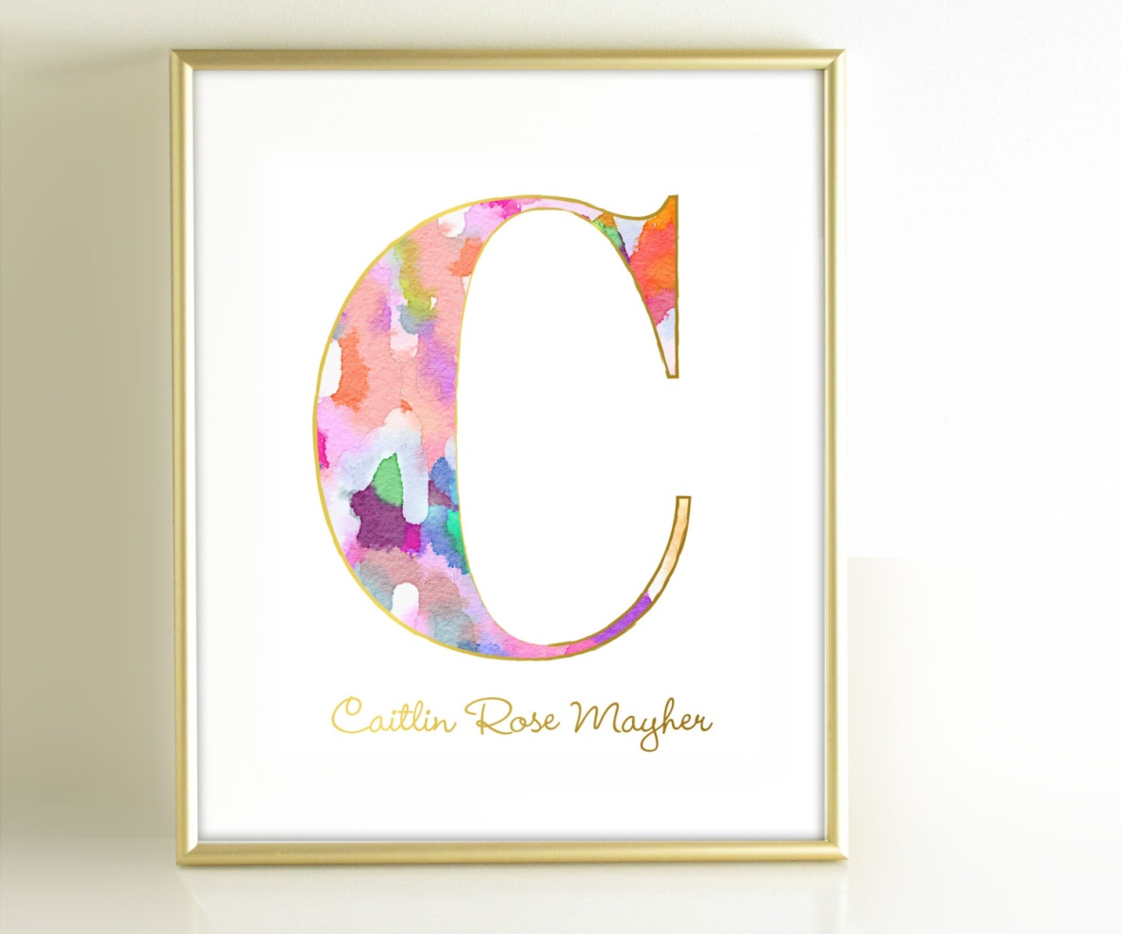
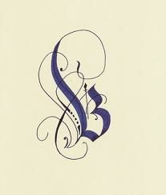
The Theme of our Guild programs during this year related to Experimenting with Colorful Backgrounds using different methods, medias and tools.
So let’s conclude this year’s program by lettering your calligraphic monograms on these colorful backgrounds.
Let’s learn some basic methods and experiment using fancy majuscules, minuscules and different fonts for this program.
Monograms are known as a design consisting of two or more alphabetic letters combined or interlaced, commonly one's initials, often printed on stationery or embroidered on clothing, etc. Whether you see your own monogram or
a company logo with your initials, we all enjoy seeing our initals on personal items, such as business cards, clothing, wallets, purses, writing instruments, wedding napkins, etc.

Slide 4
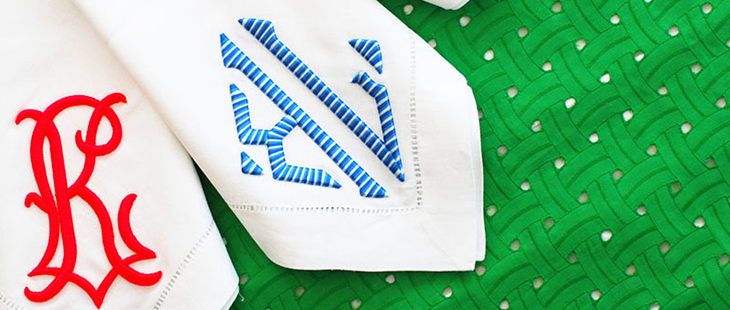
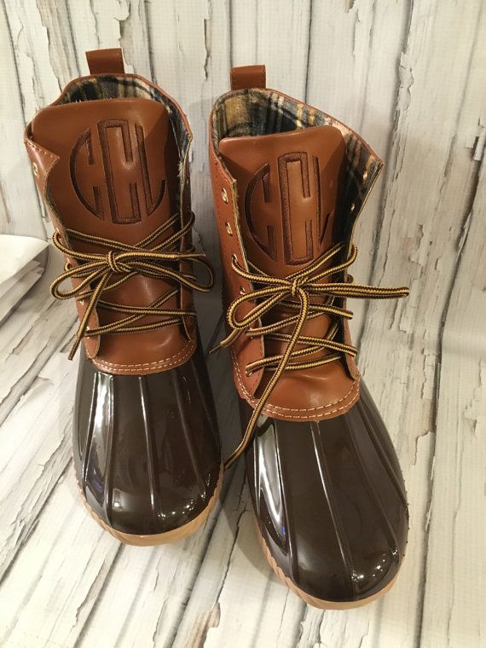
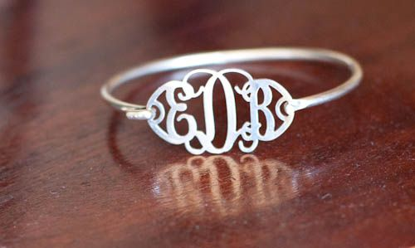

Slide 5
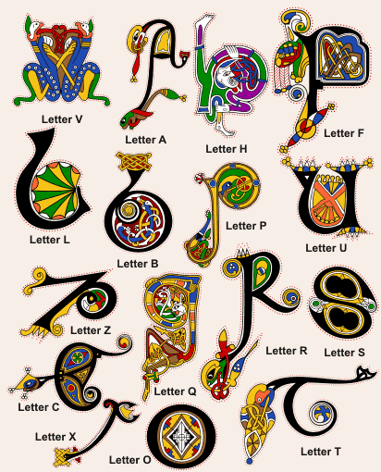
Versals are the unique decorated illumination Monograms of the beginning of chapters in books or old manuscripts.
Example from the Book of Kells.

Slide 6
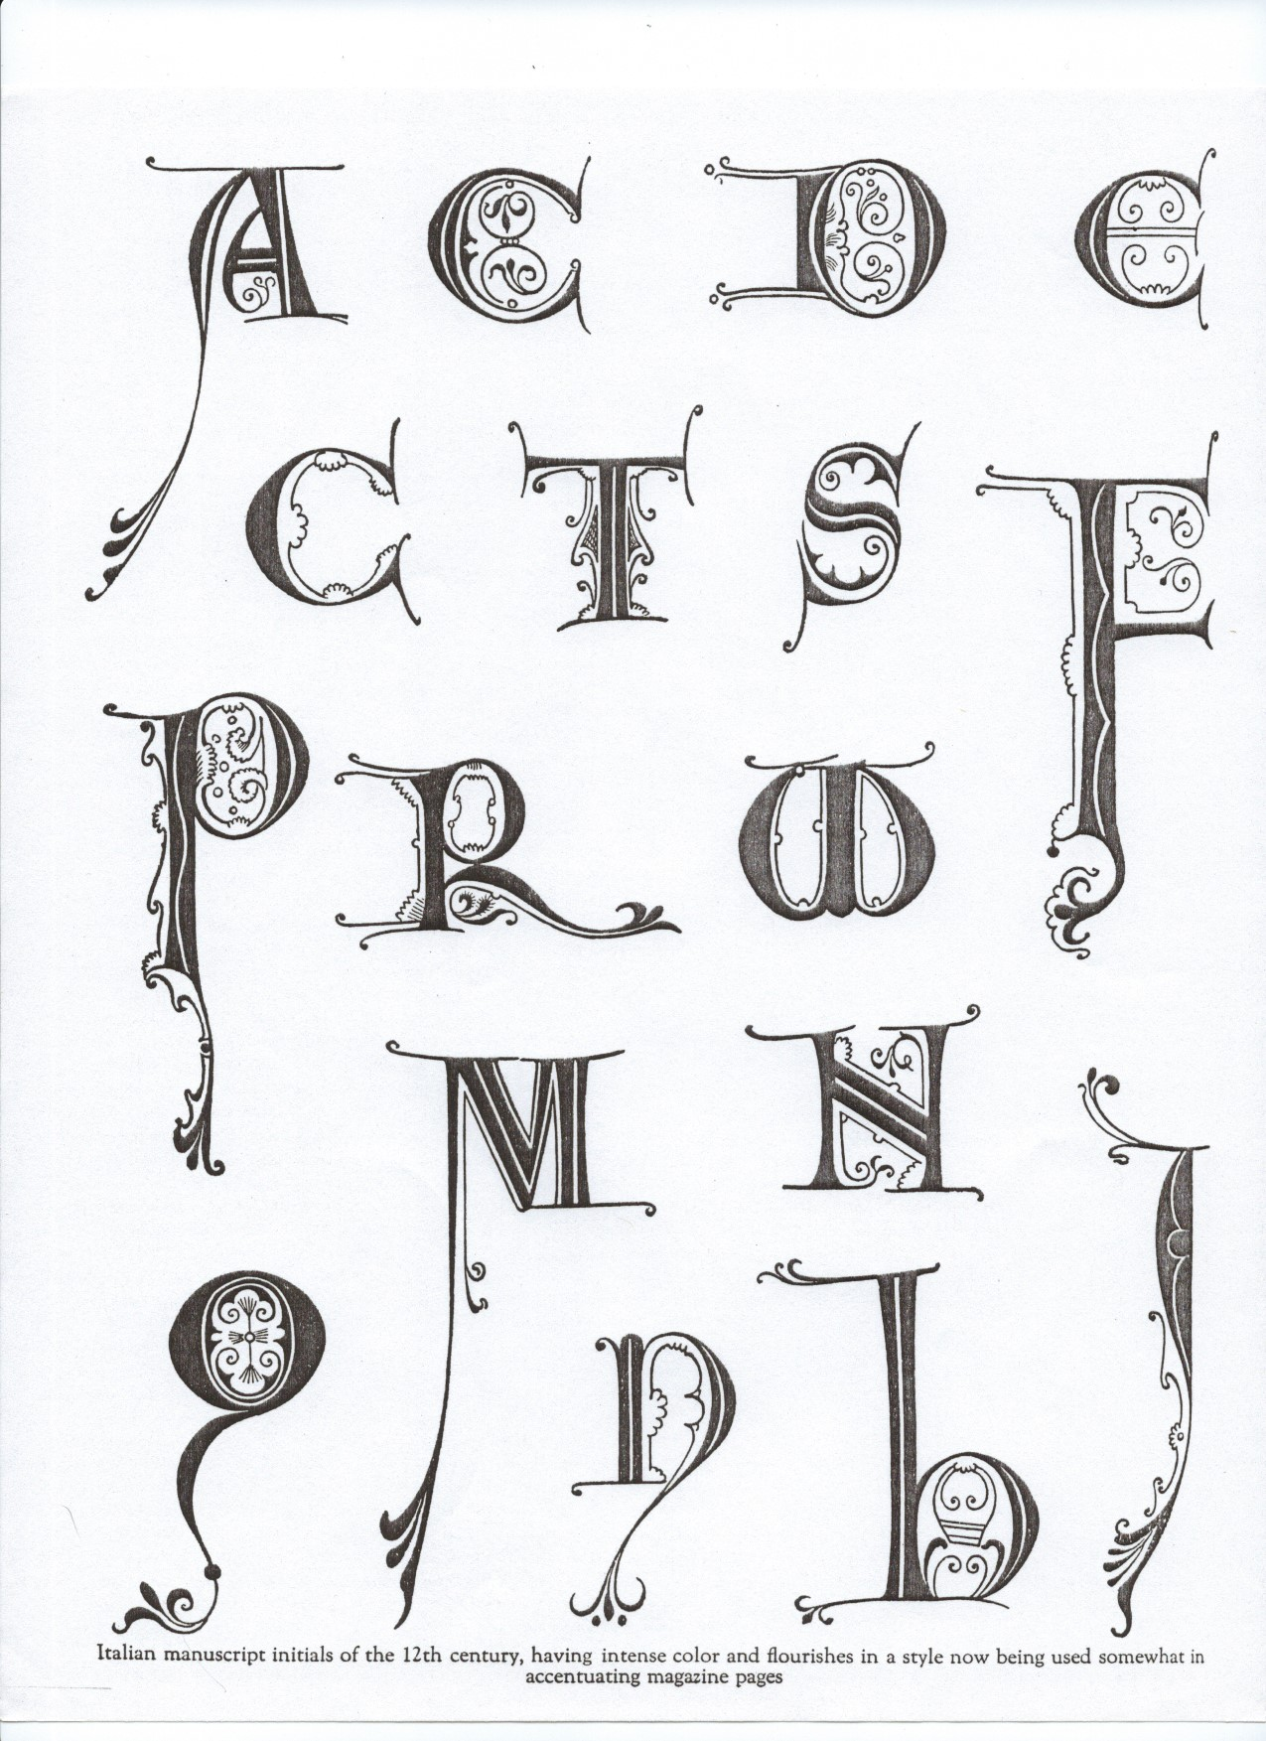
10th Century German Majuscules using white vine Gothics.
12th Century Versals

Slide 7
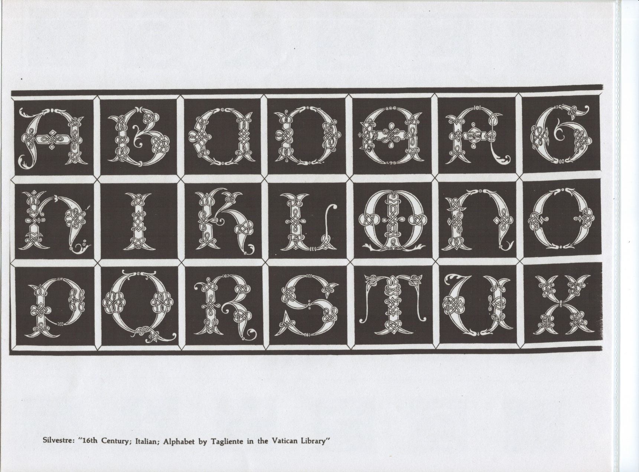
16th Century Alphabet by Tagliente in the Vatican Library

