Slide 1
It’s a Wonderful Life
Our Guild’s December Program Theme is from a favorite Christmas movie for many generations since 1946

Slide 2
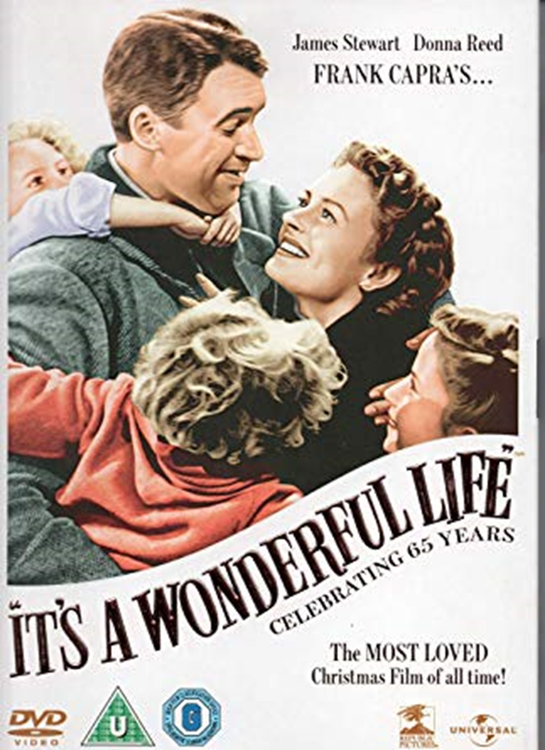
Directed by Frank Capra.
Filmed in monochrome Black and White
with James Stewart, Donna Reed, Lionel Barrymore, Thomas Mitchell.
George Bailey is a fictional character and the protagonist in It's a Wonderful Life.
The character is a building and loan banker who sacrifices his dreams in order to help his community, to the point where he feels life has passed him by. But an angel is sent from Heaven to help this desperately frustrated businessman by showing him what life would have been like if he had never existed. Clarence is the angel’s name.

Slide 3
Seneca Falls, new York claims that when Frank Capra visited their town in 1945, he was inspired to model Bedford Falls after it.
The town still has an annual "It's a Wonderful Life Festival" in December. In 2009, The Hotel Clarence opened in Seneca Falls, named for George Bailey's guardian angel. And their "It's a Wonderful Life" Museum opened in 2010.
In 1990, It's a Wonderful Life was deemed "culturally, historically, or aesthetically significant" by the United States Library of Congress and selected for preservation in their National Film Registry.

Slide 4
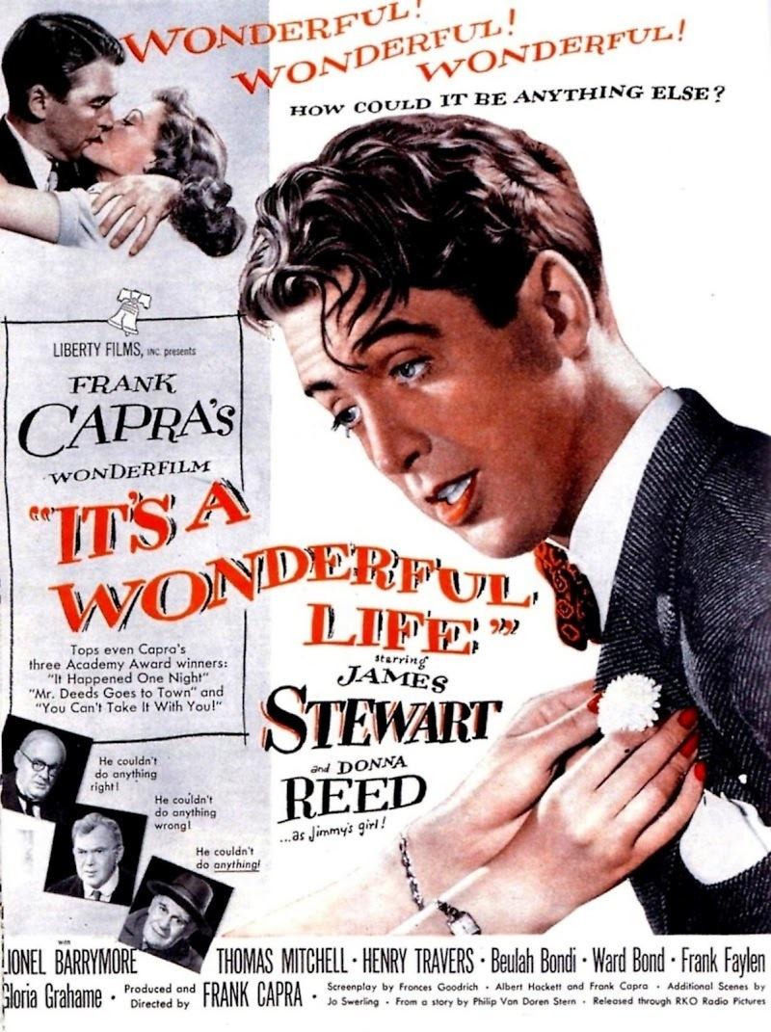
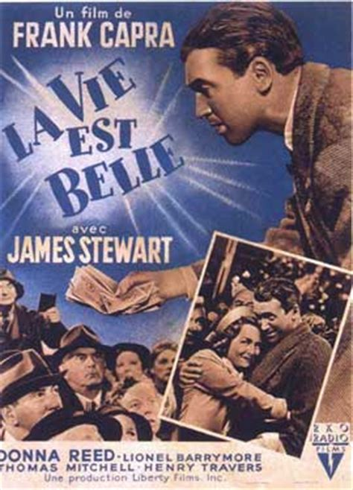

Slide 5
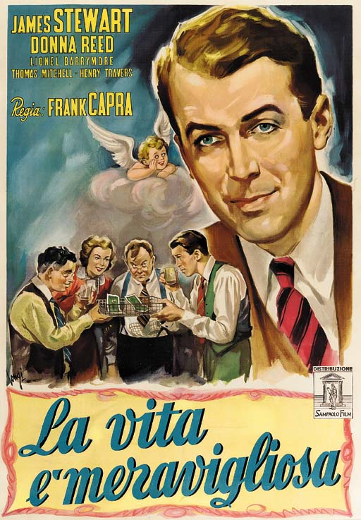
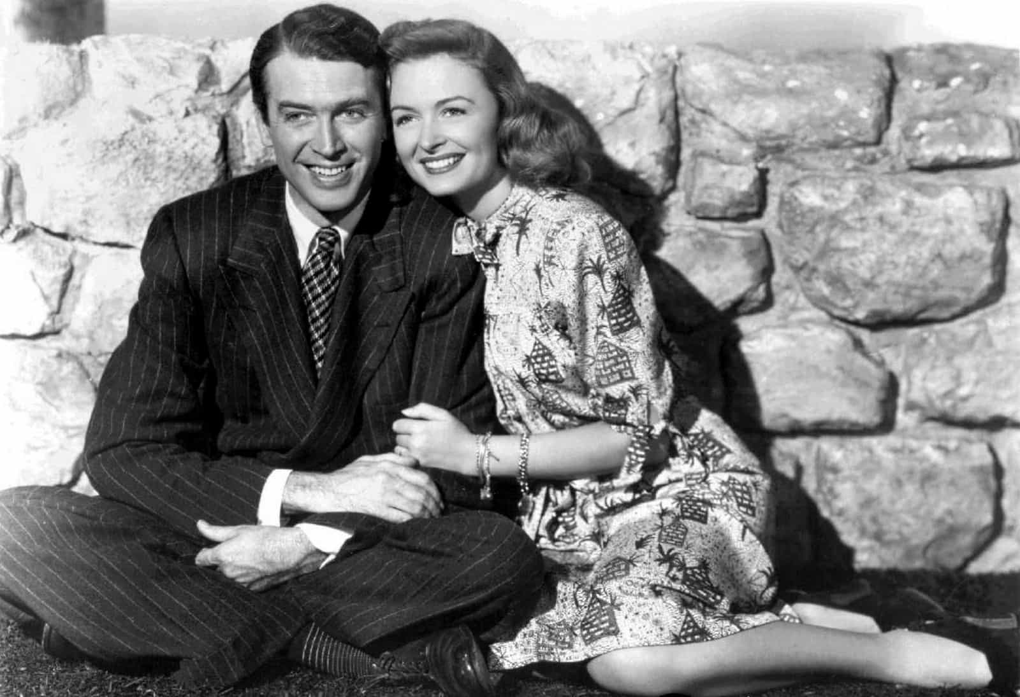

Slide 6
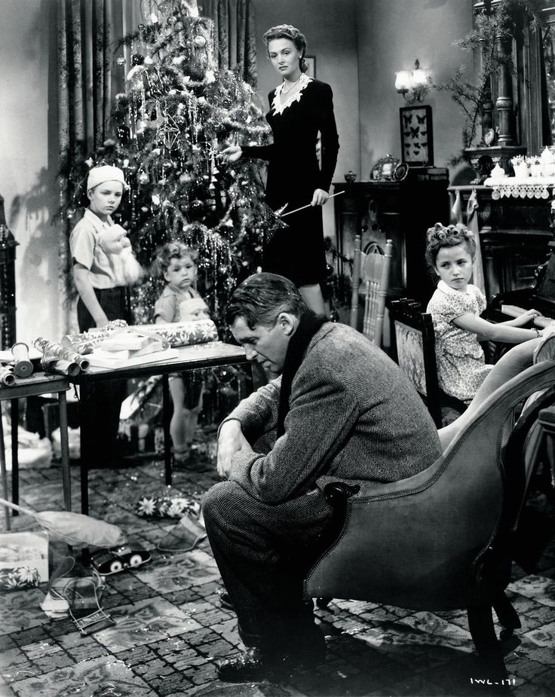
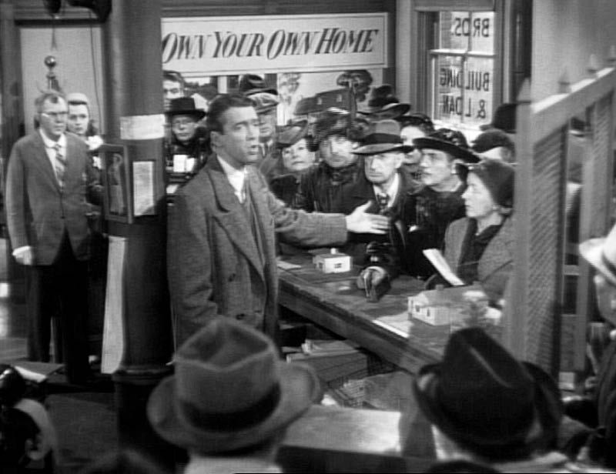

Slide 7
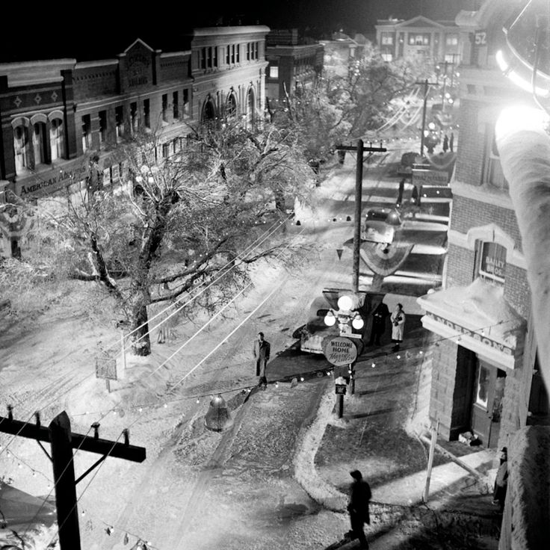
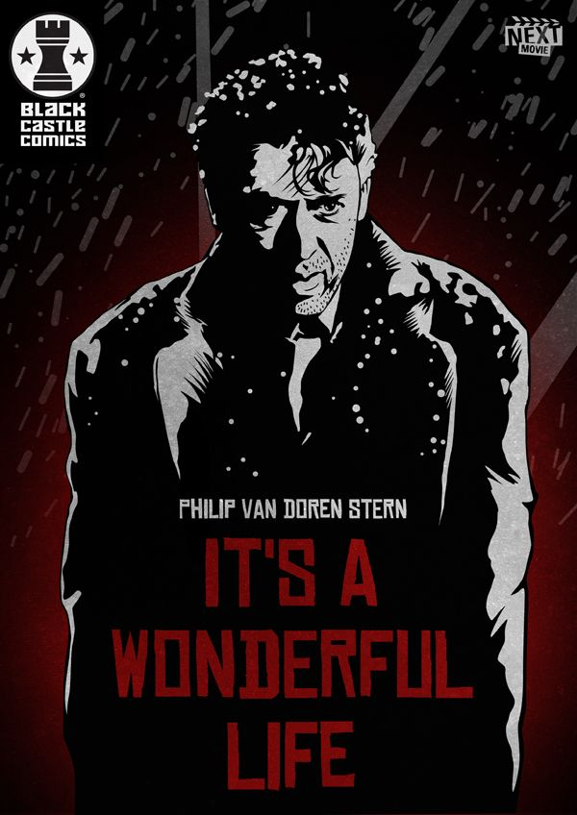

Slide 8
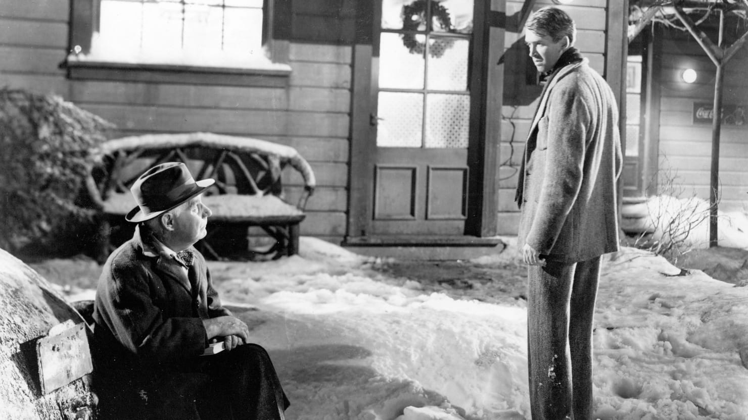
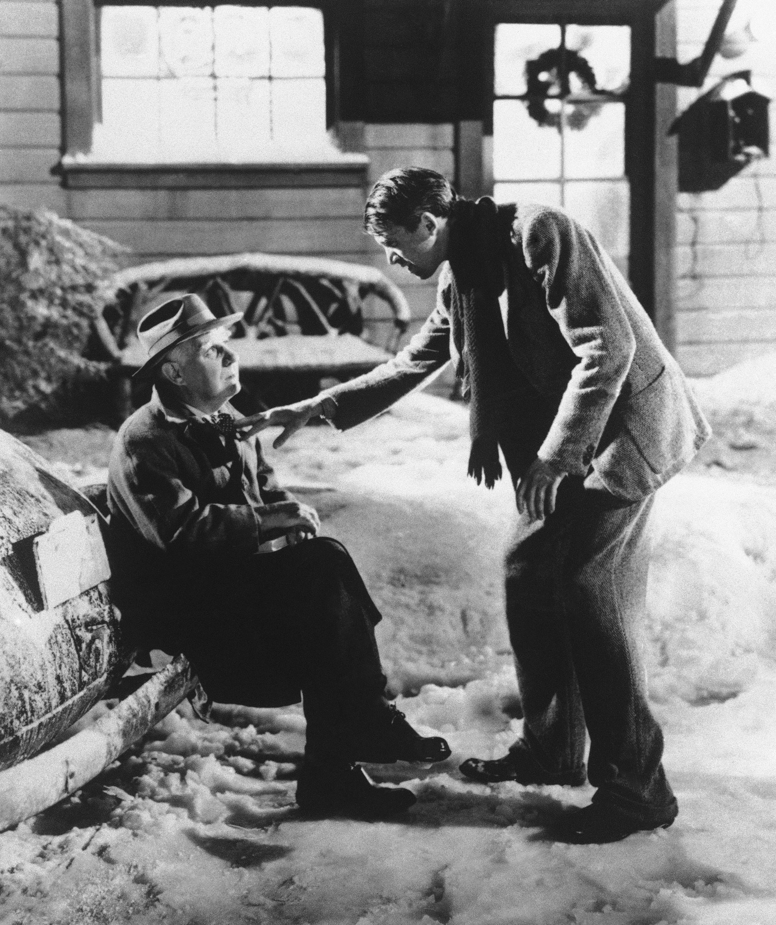

Slide 9
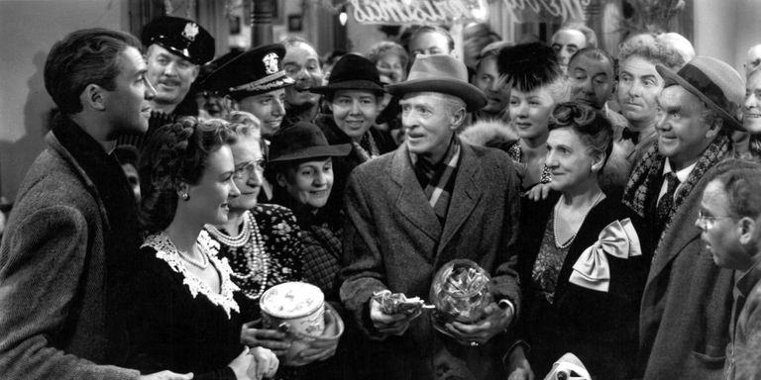
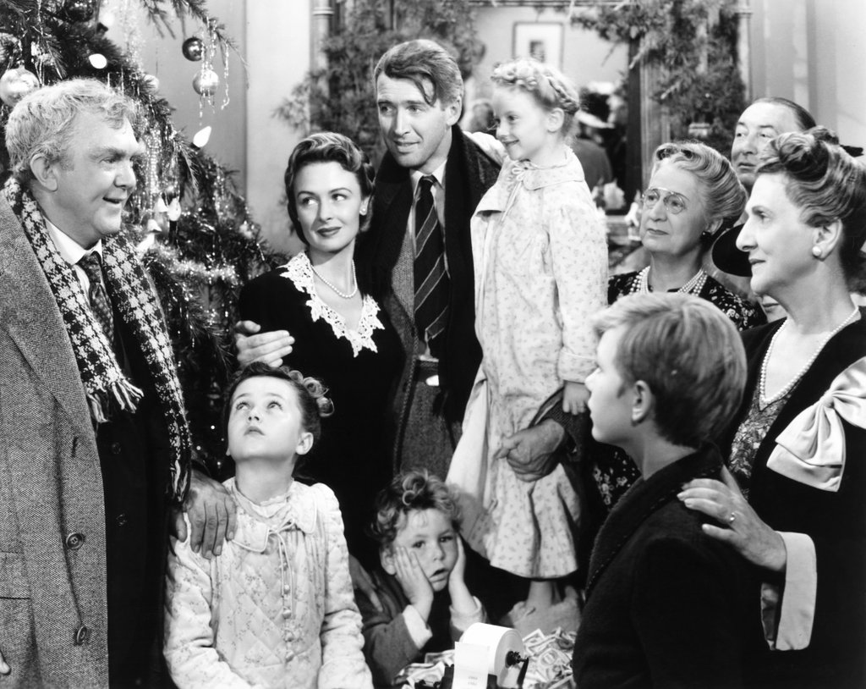
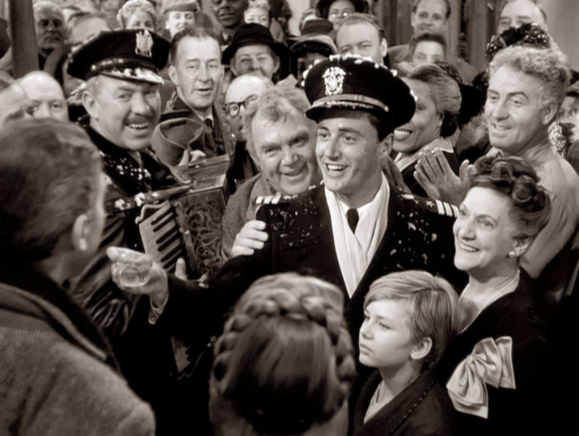

Slide 10
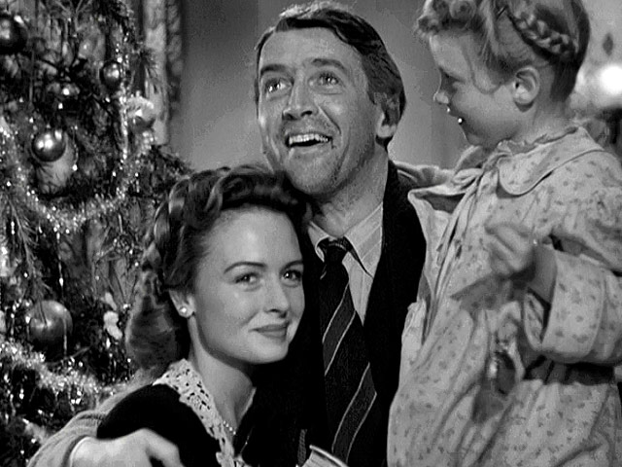
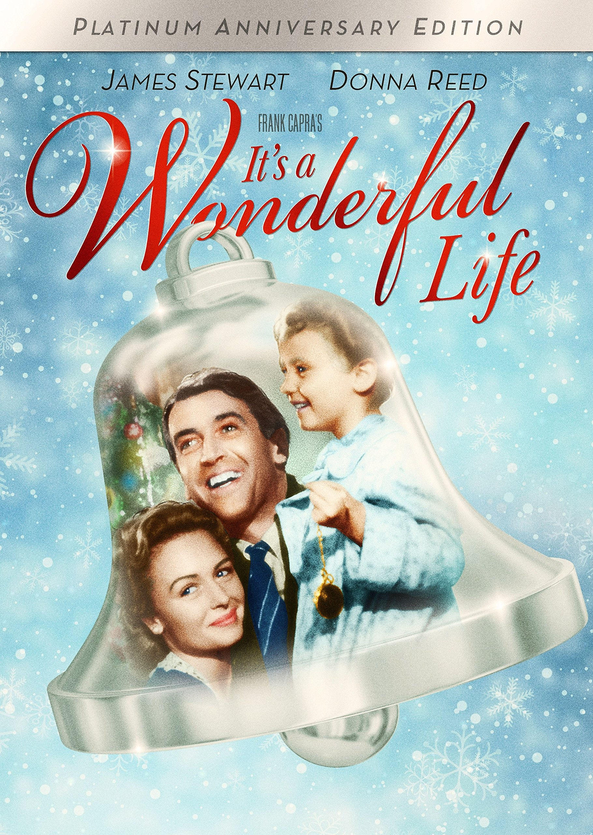
In the film’s ending, their child says,
“Look, Daddy. Teacher says, 'Every time a bell rings an angel gets his wings.’

