Slide 1
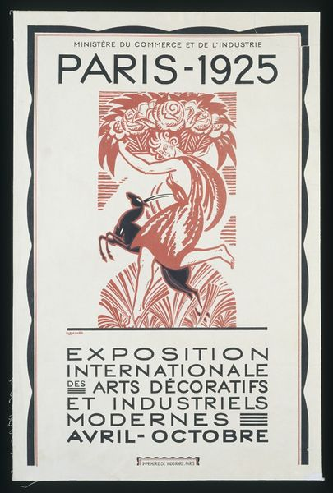
Notes:
Paris 1925 – Arts Decoratifs Exhibition. Term “Art Deco” applied in 1960’s. Other names: Moderne, Modernism, Futurism, Streamline.

Slide 2
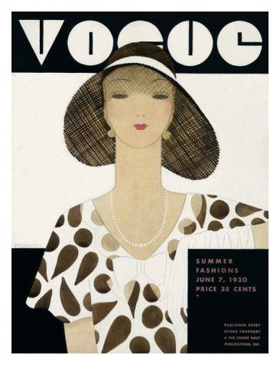
Notes:
Vogue - June 1930 – New lettering style in masthead of each issue. HAPPY MOTHER’S DAY

Slide 3
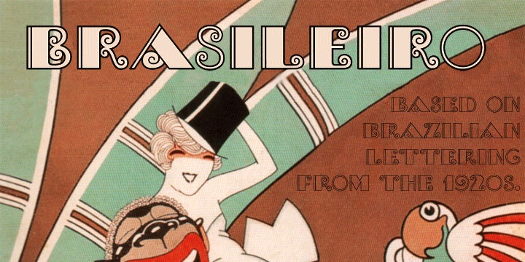
Notes:
Art Deco popular in Latin America --- Note Outline Lettering style.
European exiles escaped turmoil and persecution in war times. Went to Brazil, Argentina, Chile, Mexico.

Slide 4
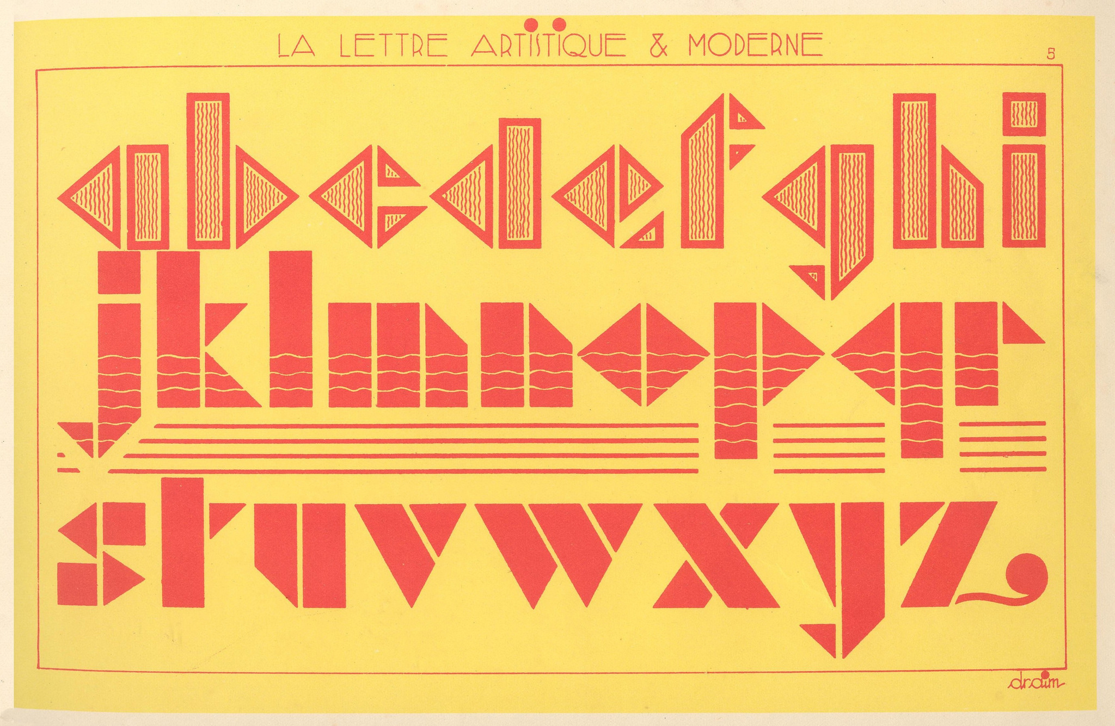
Notes:
From DRAIM – “Le Lettres Artistiques et Moderne” Flickr: Patricia M (Agence Eureka). Excellent website.
Geometric, colorful alphabets for commercial art, illustration and display lettering.

Slide 5
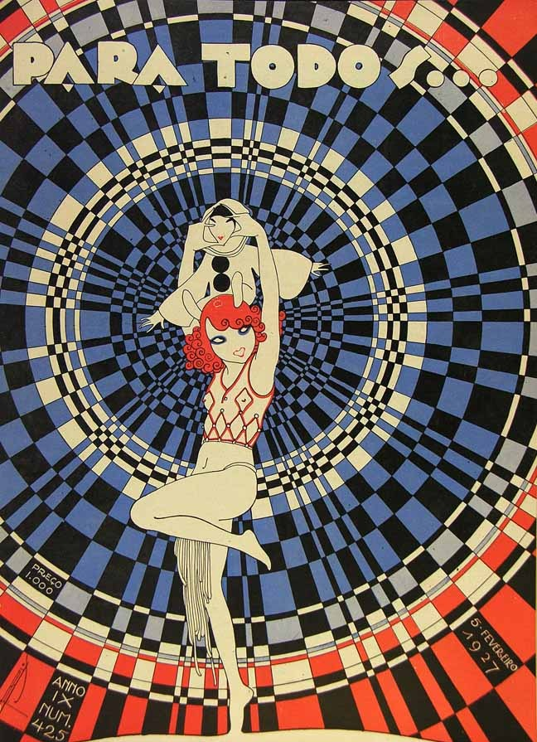
Notes:
PARA TODOS – FEVREIRO 1927 – DESIGN Elements & Principles: COLOR, SHAPE, FORM, CONTRAST, REPETITION, BALANCE, etc.

Slide 6
Notes:
A.M. CASSANDRE – BIFUR 1928 - an “iconic” typeface. Also see SEYMOUR CHWAST “ARTONE” typeface

Slide 7
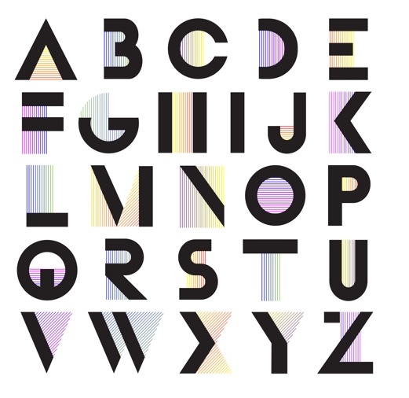
Notes:
A.M. Cassandre – BIFUR …. Keeps on ticking. SEE : “Dick Pape” and “Nick Curtis” … typeface digitizers at luc.devroye.org

Slide 8
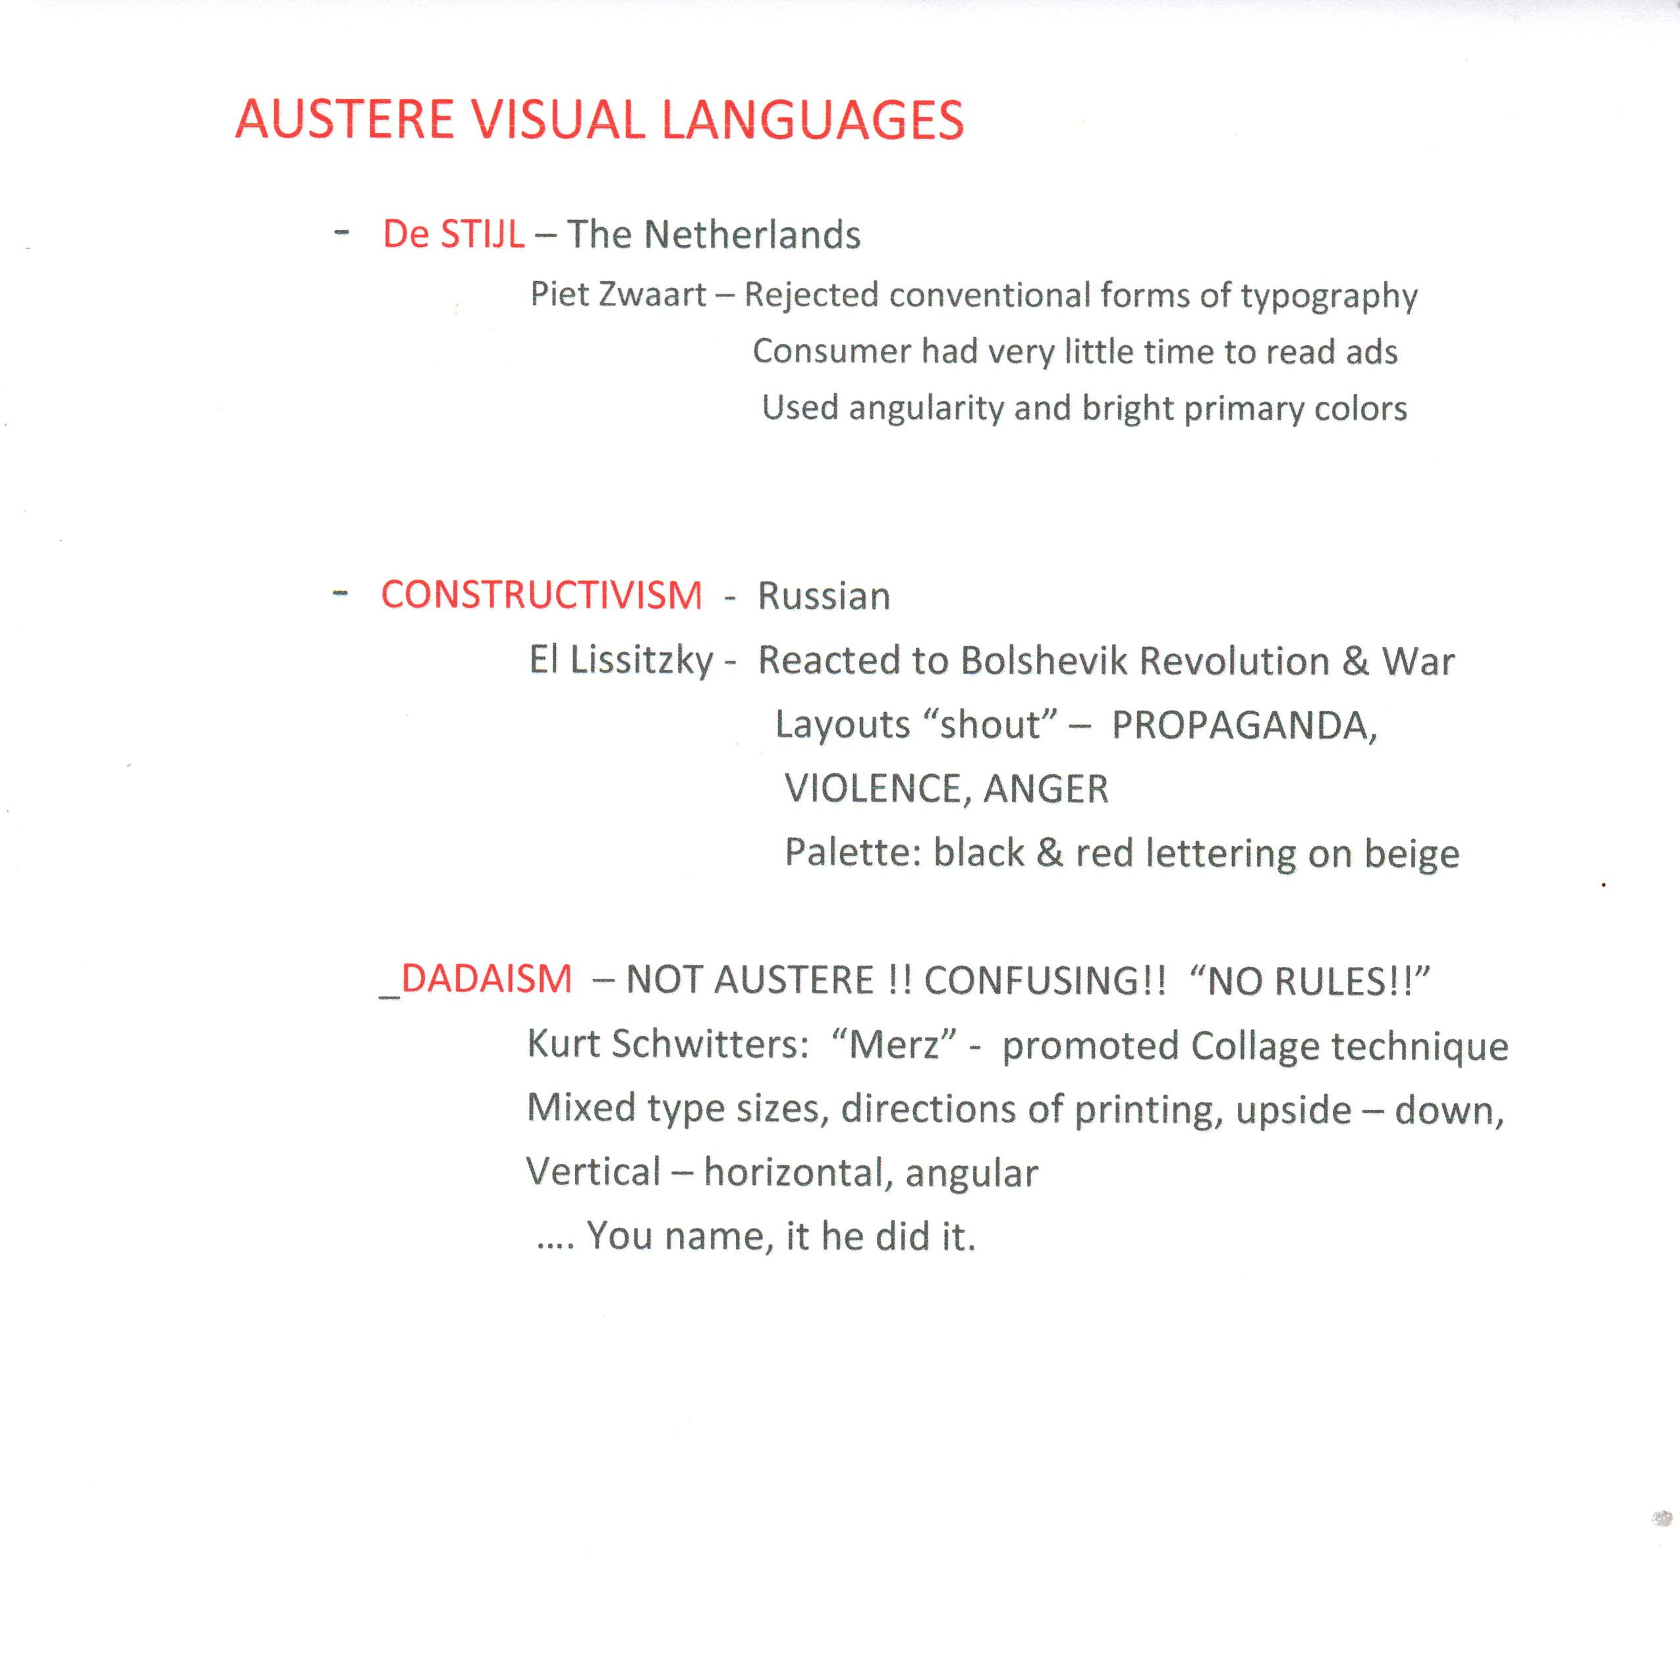
Notes:
Truly impacted by atrocities of WW I, Russian war, emotional distress, social upheaval ...Anti-Anything & Everything!!!

Slide 9
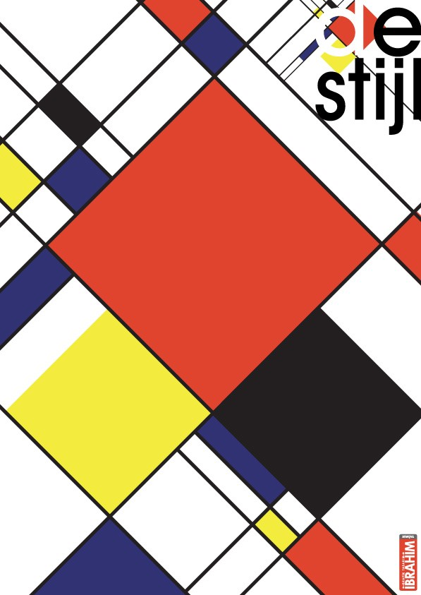
Notes:
DeStijl -Geometric, basic angularity, primary palette. No curves.
Theo Van Doesburg & Piet Mondrian promoters. Piet Zwaart posters

Slide 10
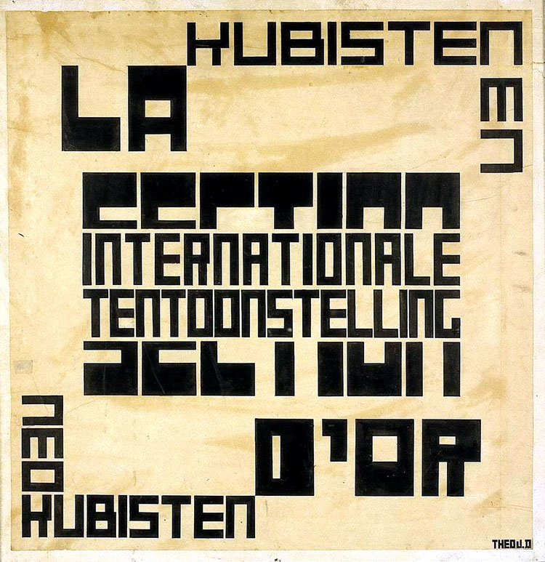
Notes:
Theo Van Doesburg – 1917 – DeStijl Manifesto – keep it square, keep it simple

Slide 11
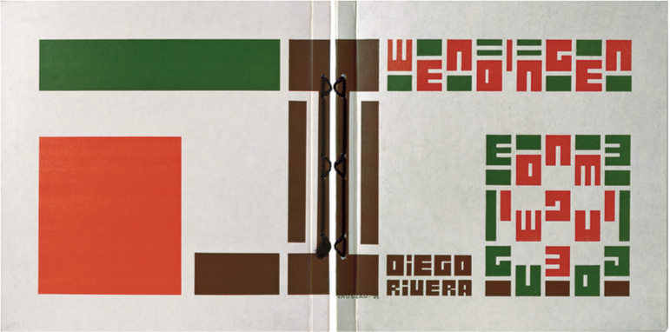
Notes:
WENDINGEN Magazine 1924 – Diego Rivera Issue -- Square format ---BOUGHT ANY SCRAPBOOK ALBUMS LATELY??

Slide 12
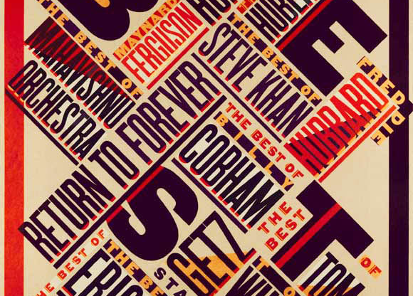
Notes:
CONSTRUCTIVISM – Modern 1979 poster by Paula Scher for CBS Records. Russian constructivism plus wood type lettering.
Basic palette for Constructivist works : black and red letters on tan background. This one has touches of orange and white.

Slide 13
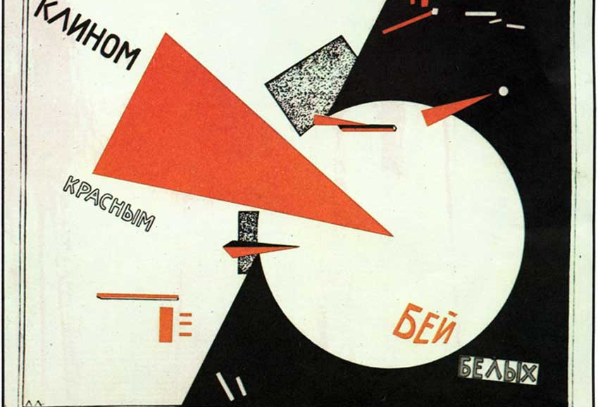
Notes:
CONSTRUCTIVIST – EL Lizzitsky - primary influencer Red Arrow. This is classic poster of the movement. Red Army Vs White Army

Slide 14
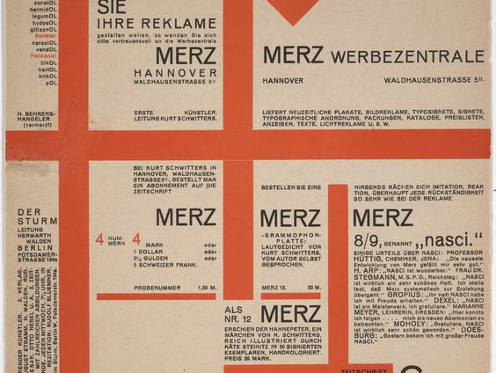
Notes:
DADAISM – Kurt Schwitters - anything goes … anti everything!! Collage, collage…. “calligraphic art??”
MERZ – became name for movement…. It is part of word “commerz”

Slide 15
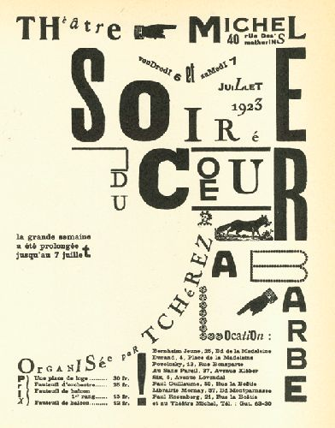
Notes:
TYPOGRAPHY – Dada style,1923. Any size, any direction, any style of letter…. No rules. Calligraphic Art???

Slide 16
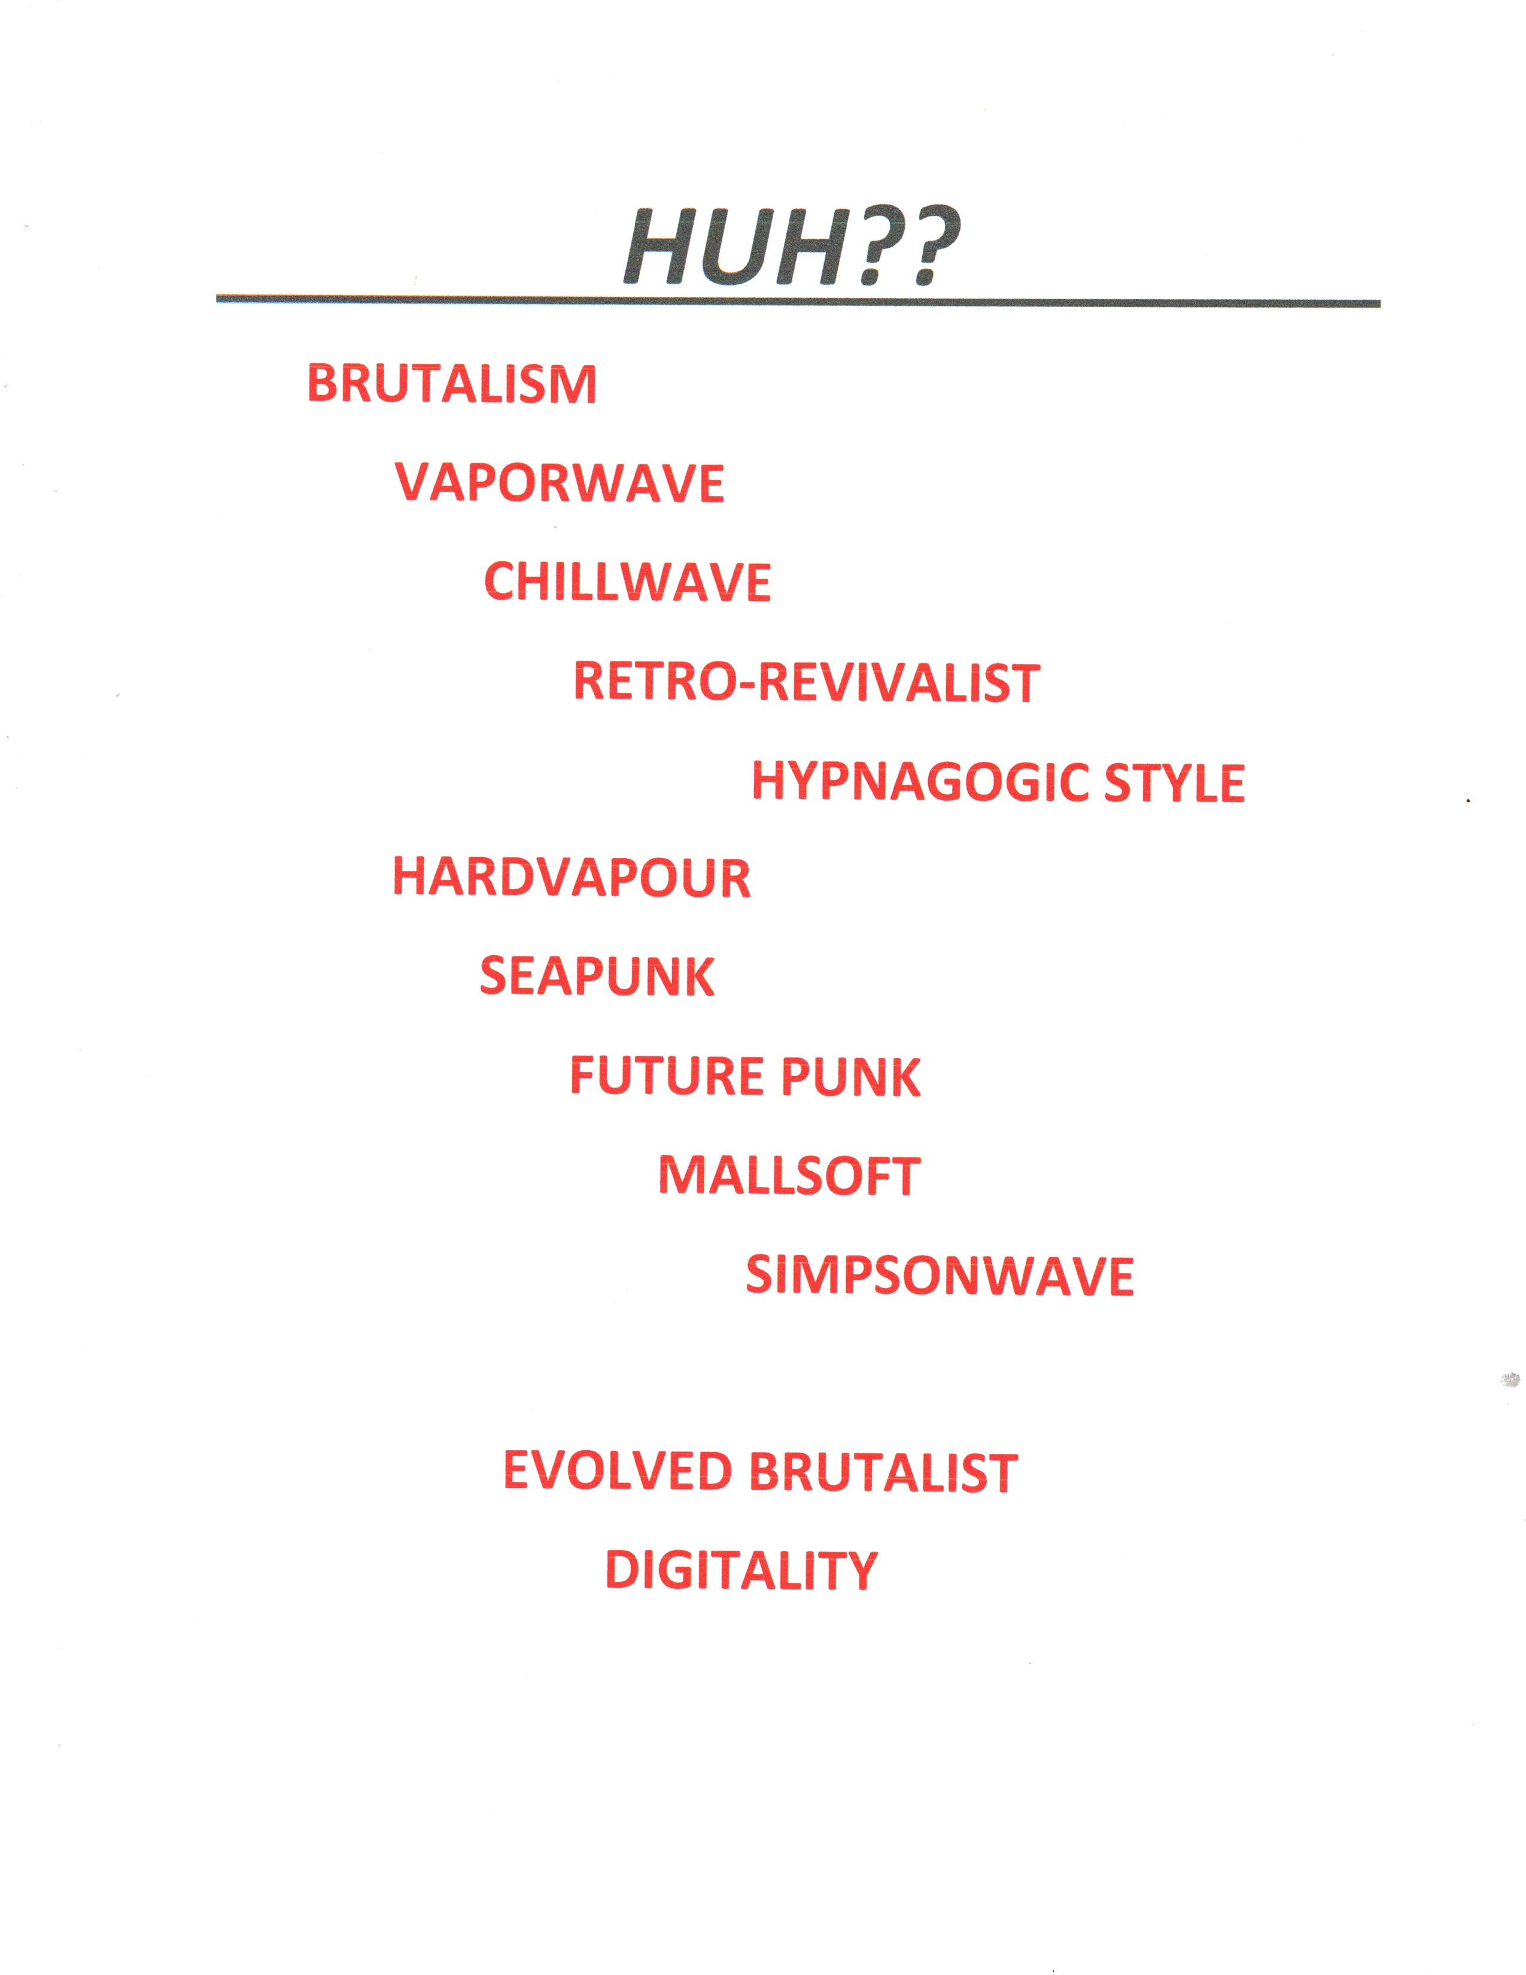
Notes:
Psychedelic Typefaces & Hippie Typefaces , Distressed and Weathered Typefaces….
Hippies & Flower Children VS Punk & Grunge… See Neville Brody typefaces (ACADIA Condensed) at luc.devroye.org
Analog vs Digital

Slide 17
Notes:
Maybe some nice letters to inspire Decorated Lettering in different styles

Slide 18
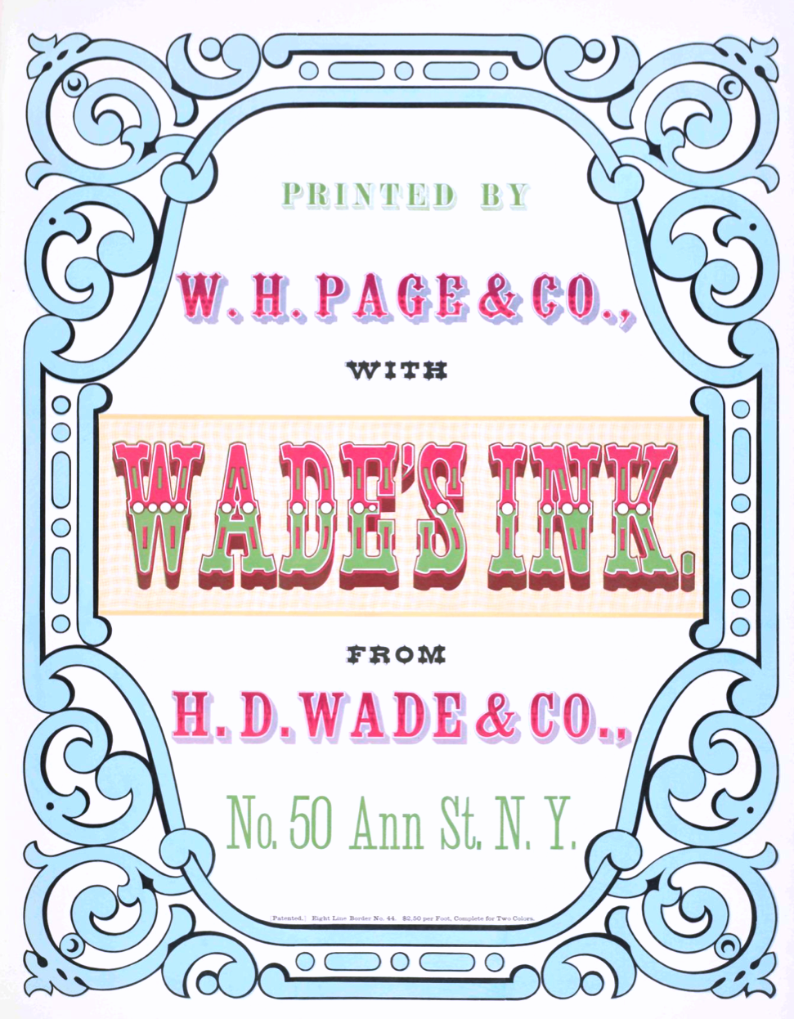
Notes:
William Page Specimen Book 1874 – aka: “Circus Style”, “Cowboy Style”, “Western Style” See Rob Roy Wood-Type collection too.

Slide 19
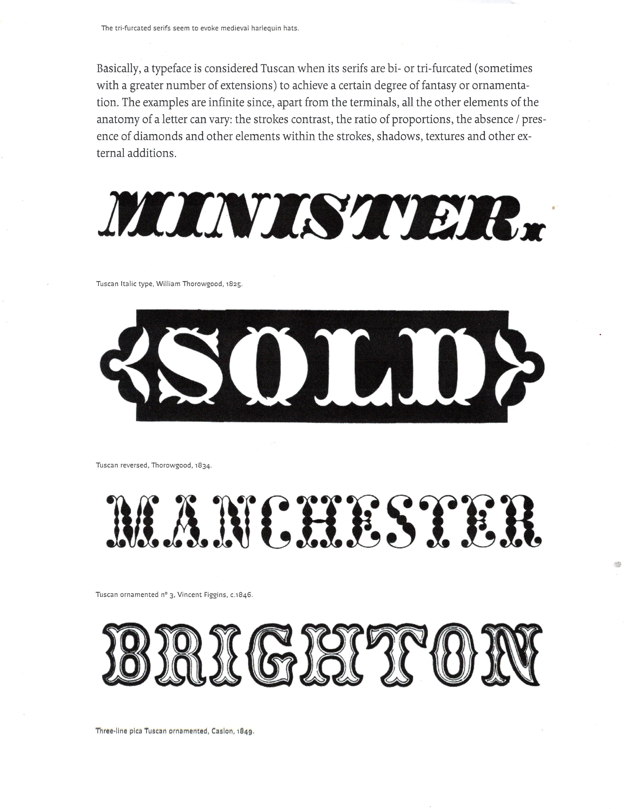
Notes:
TUSCAN LETTERS - Manchester looks like today’s dotted line lettering of 16th century.

Slide 20
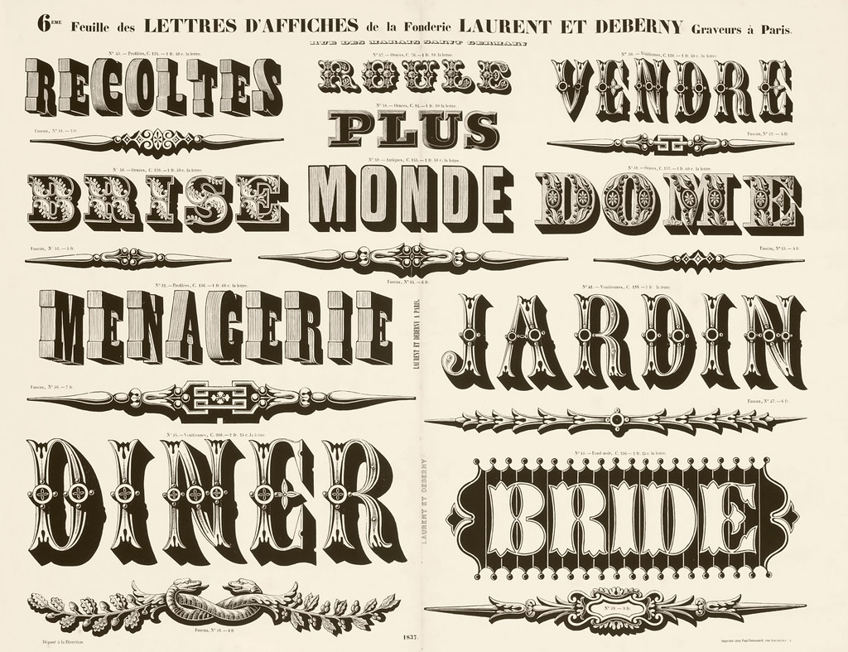
Notes:
Lettres de Affiches – Laurent et Deberney Fonderie . Maybe this a nice lettering style for “illuminated” or “ornamented” lettering”?

Slide 21
Notes:
FAT FACES – blackletter style BTW: 72 points = I inch; 12 pts = 1 PICA; 6 picas = 1 inch.

Slide 22
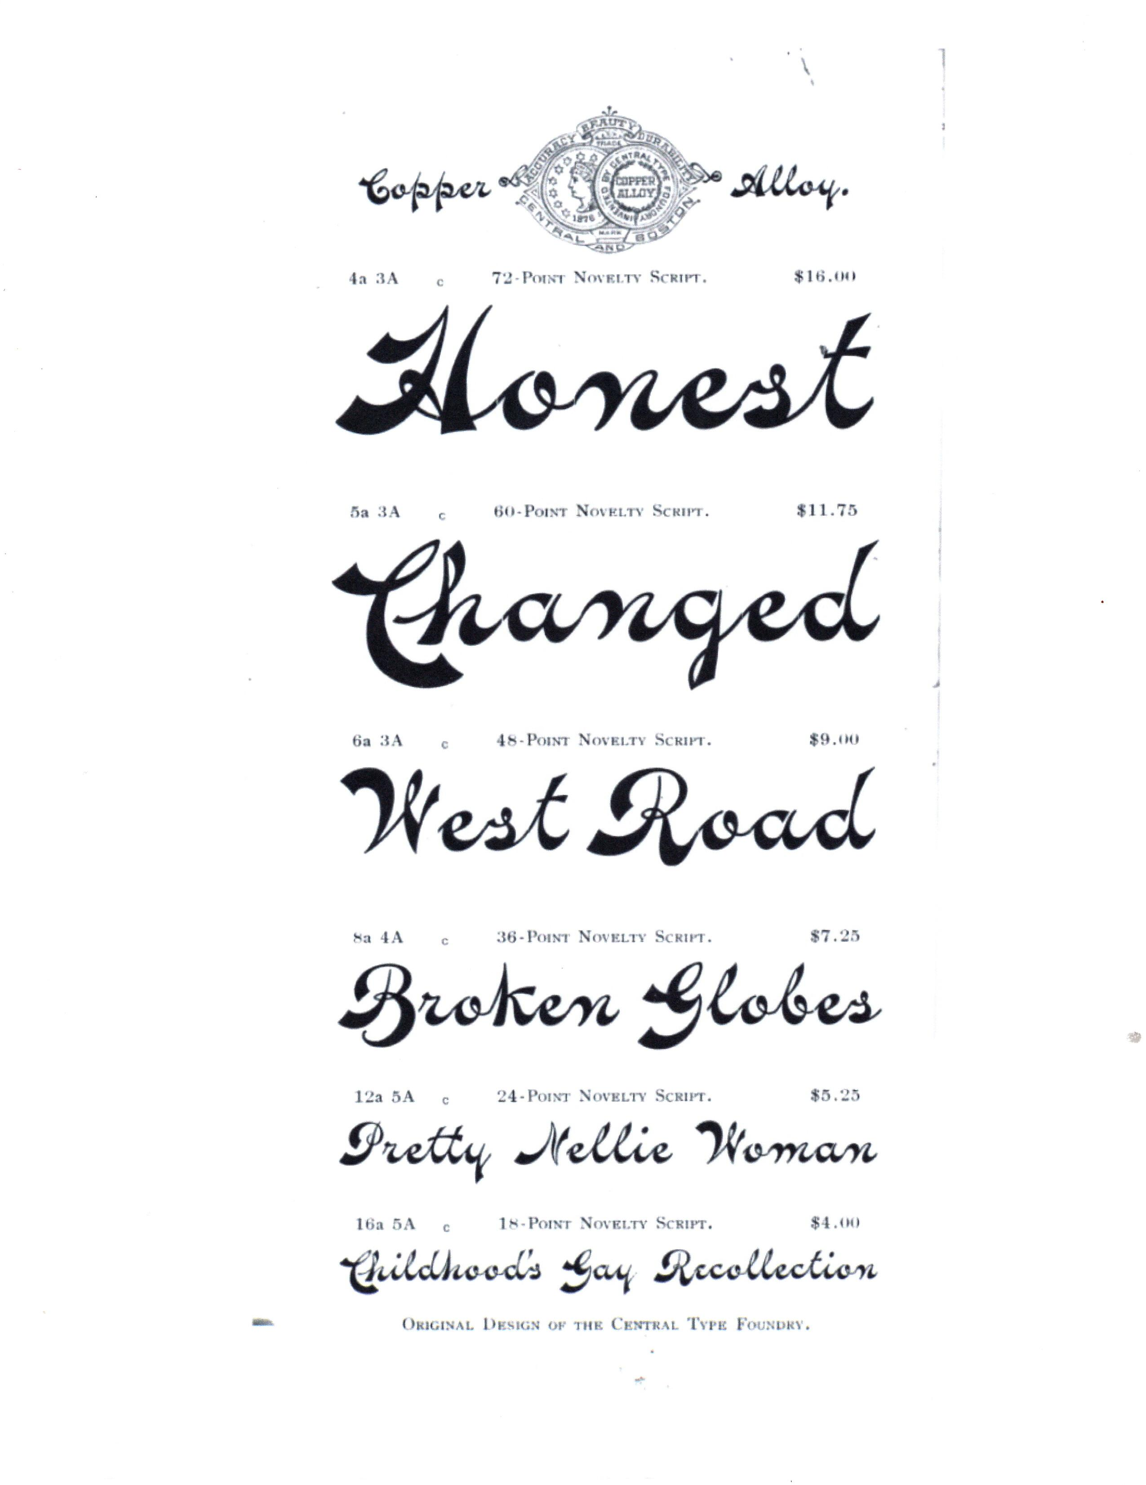
Notes:
Fat Face – cursive scripts – still in use See luc.devroye.org for Cursive typefaces, Wedding Script, Calligraphic typefaces. Display scripts.

Slide 23
Notes:
Long before it was NOUVEAU… there was WOOD TYPE Lettering used as Display Type

Slide 24
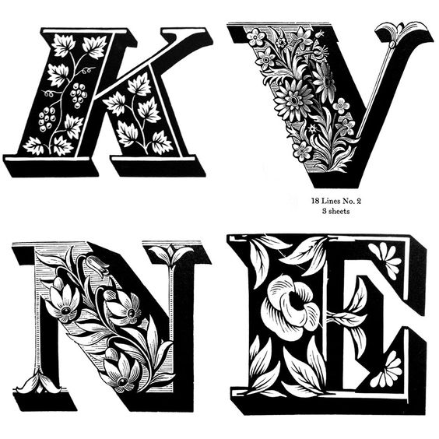
Notes:
Louis John Pouchee designed 1820 – 4 Inches… up to 8 inches… GREAT FOR “Illuminated” or “Ornamented” letters with PIZZAZZ!

Slide 25
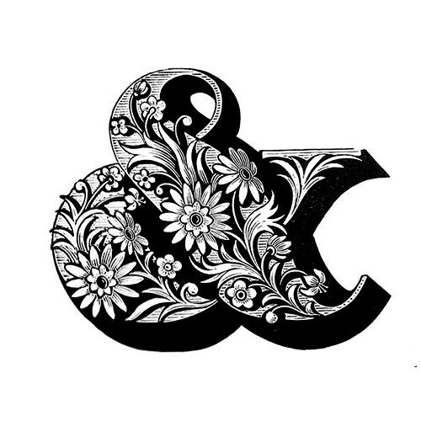
Notes:
AND … Louis John Pouchee

Slide 26
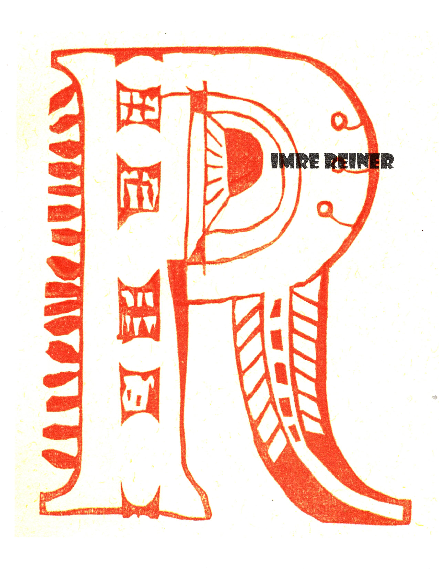
Notes:
BUT WAIT… THERE IS MORE ….IMRE REINER 1940’s German Designer

Slide 27
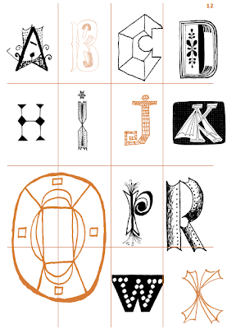
Notes:
IMRE REINER (1900-1987 Hungary). Worked in US 1923-25. See Friedrich Hermann Ernst Schneidler at luc.devroye.org

Slide 28
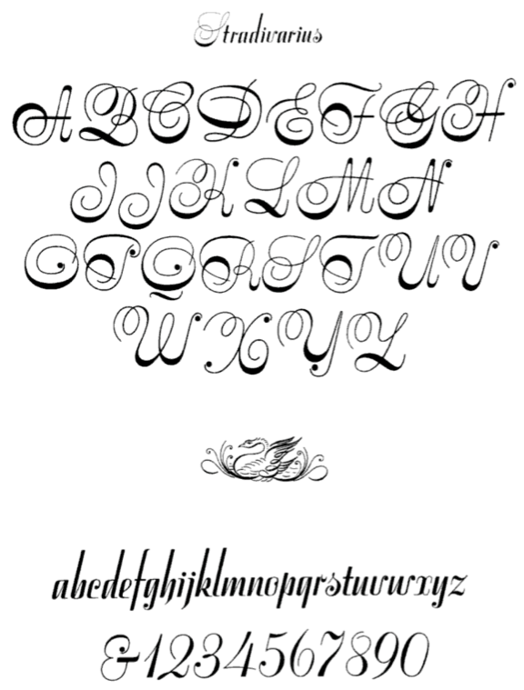
Notes:
STRADIVARIUS – 1945 by Imre Reiner There is more to pointed pen styles than “copperplate” or “Spencerian”

Slide 29
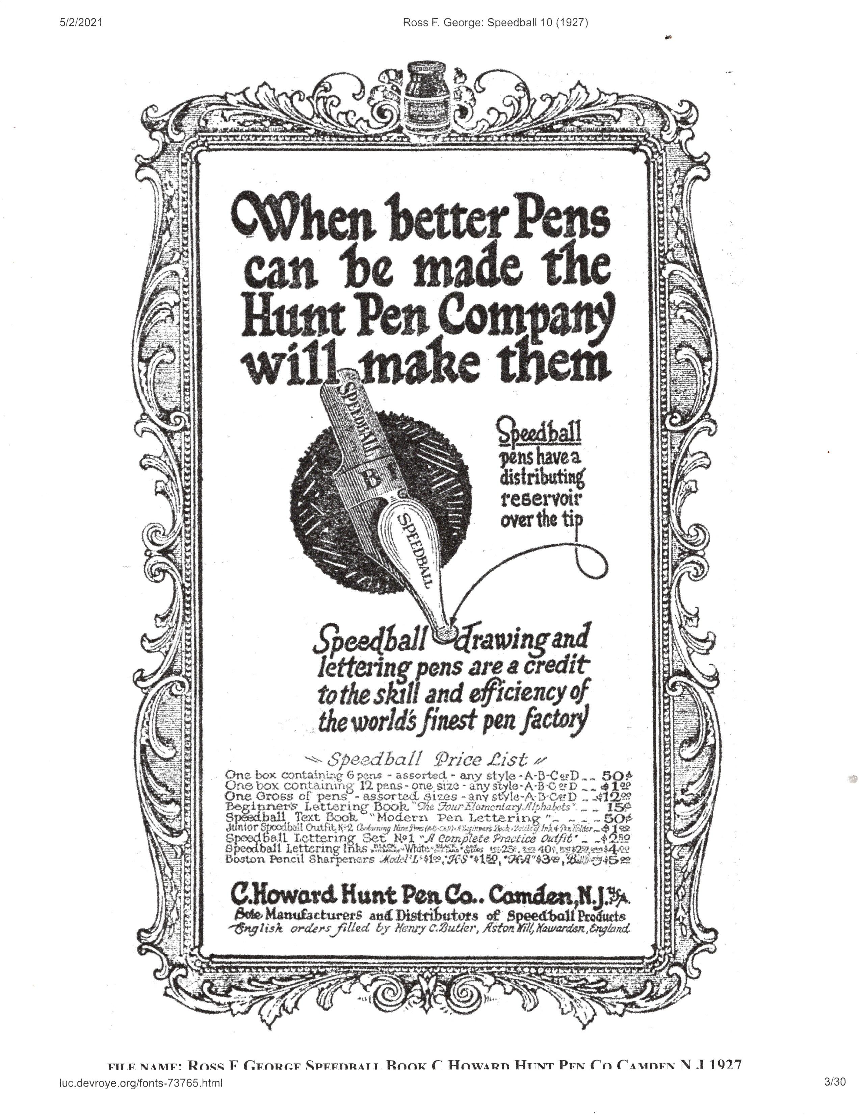
Notes:
See luc.devroye.org – Ross F. George: Speedball Text #10 (1927). It is better to study/see lettering done during the particular era.

Slide 30
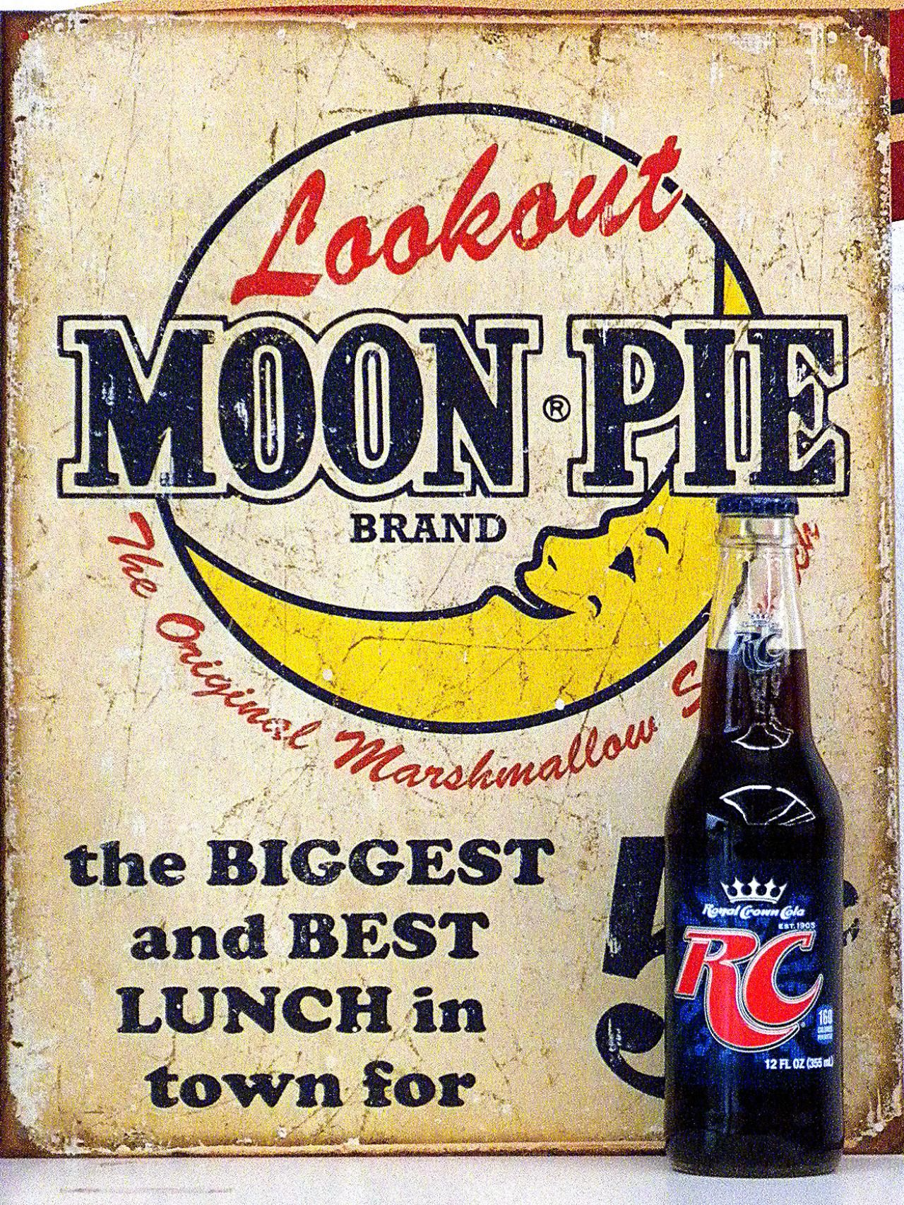
Notes:
OKAY!---It’s time for “Me and my RC” …..Check you later alligator!... bidi–bidi-bidi -THAT’S ALL FOLKS !!

